Slide 1
BEAUFORT
The solution after storm
GEO1005 - SDSS
Laurens Oostwegel, Jet ten Voorde, Puck Flikweert

Slide 2


Slide 3
Contents
Why Beaufort?
User requirements
How does it work?
Visualisation
Future improvements
Conclusions

Slide 4
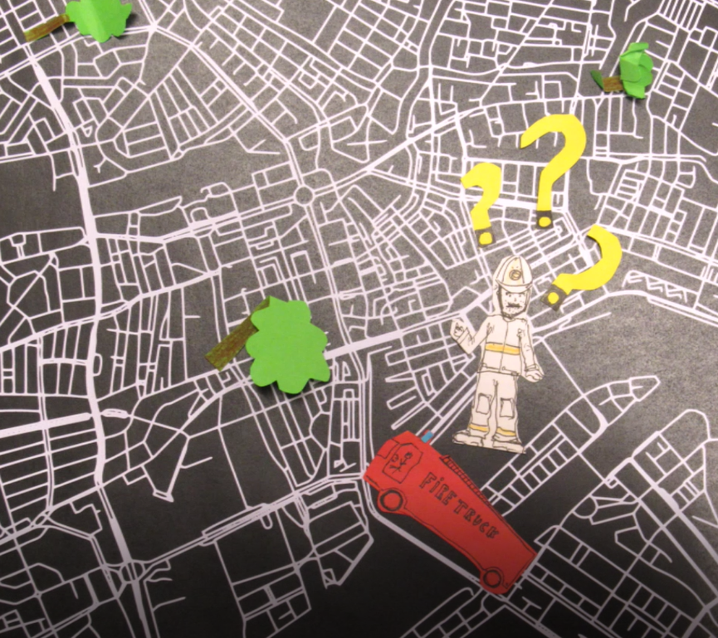
Why Beaufort?
1. Why Beaufort?
2. User requirements
3. How does it work?
4. Visualisation
5. Future improvements
6. Conclusions
In what order to solve which roadblocks with which trucks?
How to combine different priorities in one decision?

Slide 5
User Requirements
1. Why Beaufort?
2. User requirements
3. How does it work?
4. Visualisation
5. Future improvements
6. Conclusions
Prioritise blockages
Minimalistic, fast and easy to use
Feedback on why a route is chosen
Multiple users > login & connected via GPS
Reporting function
Routing takes into account blockages

Slide 6
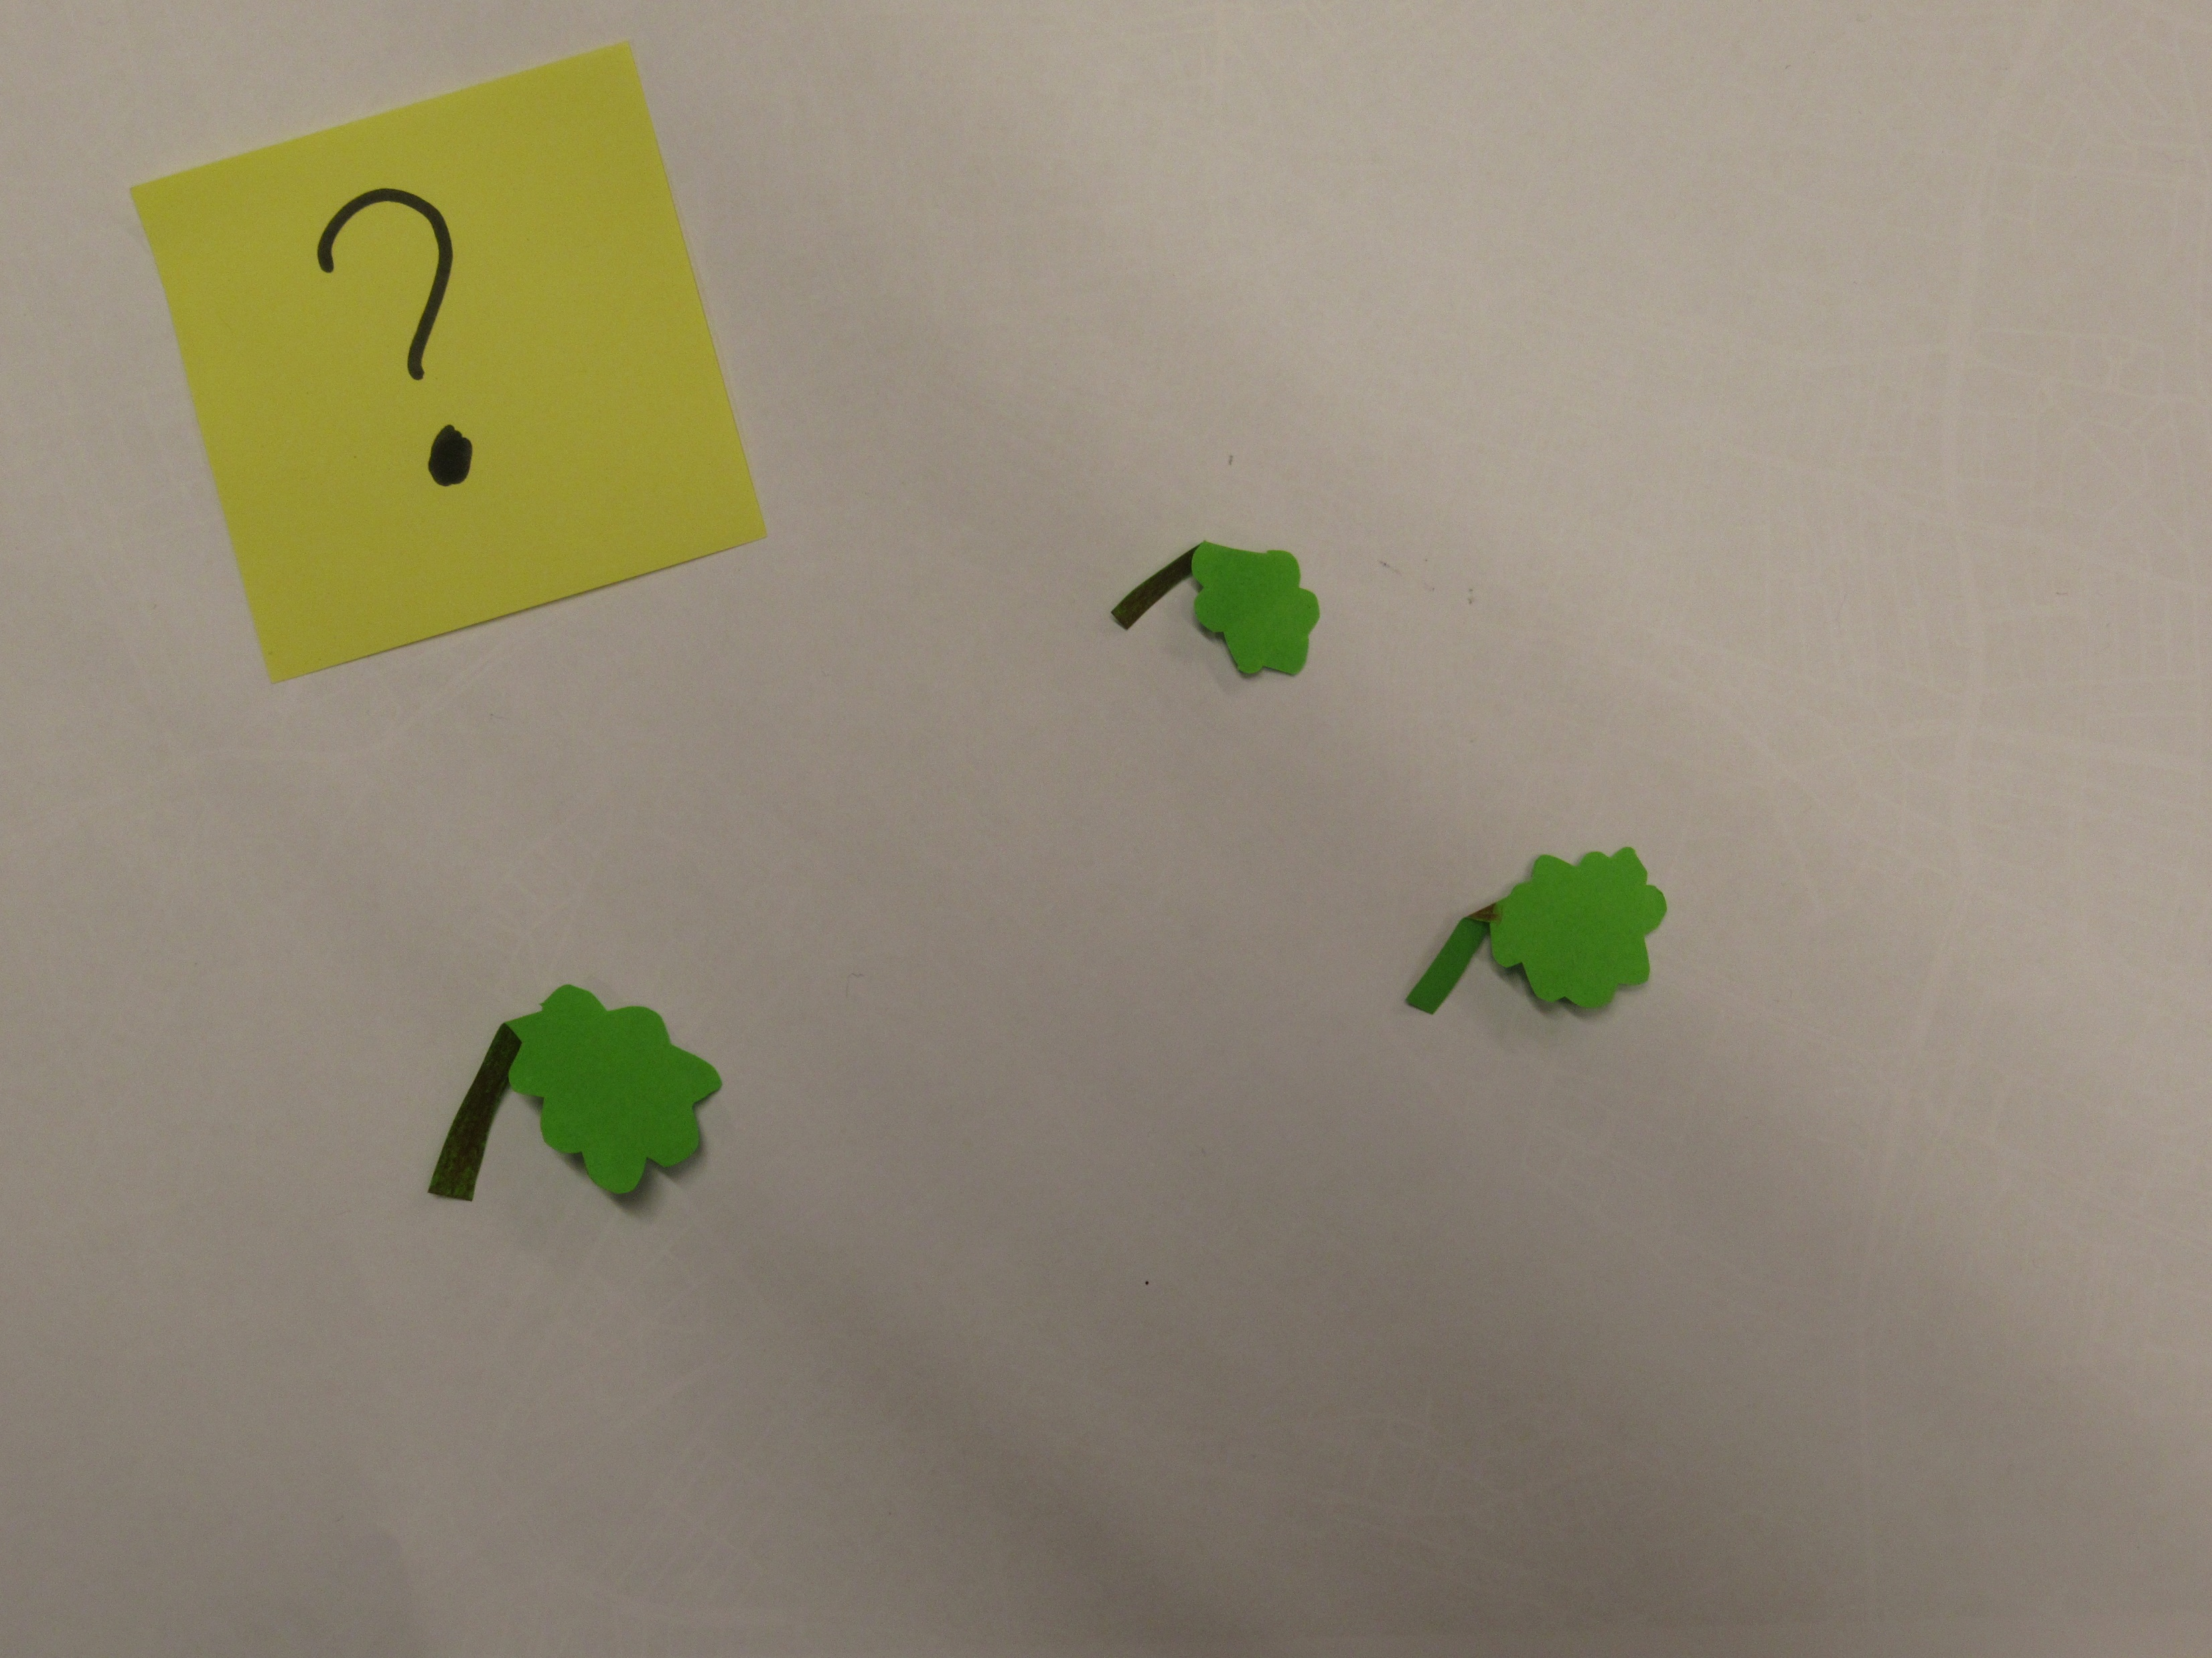
How does it work?

Slide 7


Slide 8
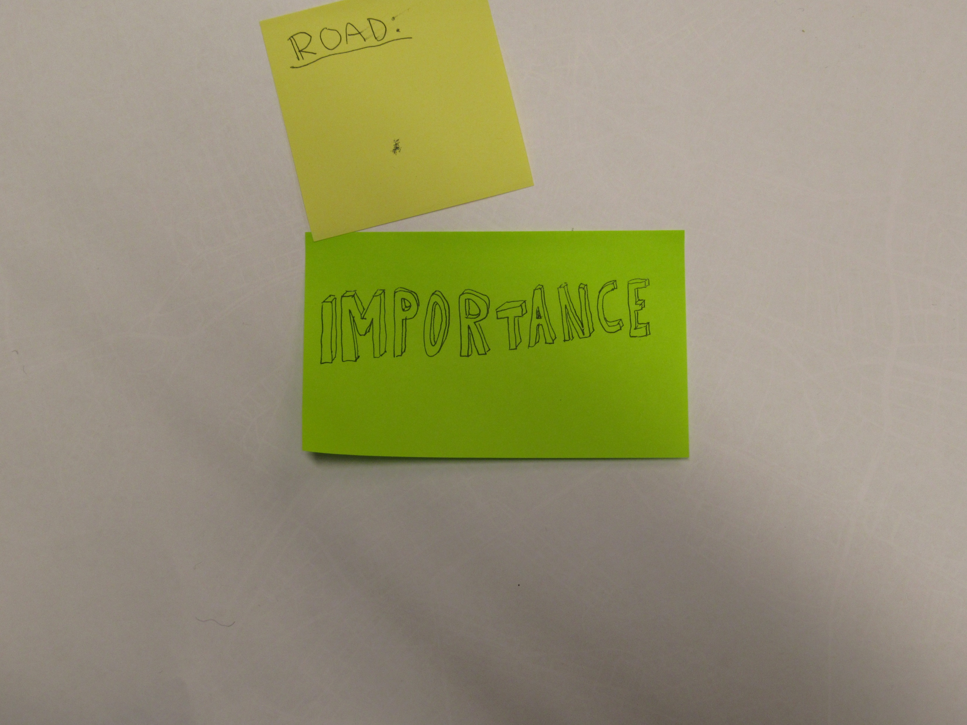

Slide 9
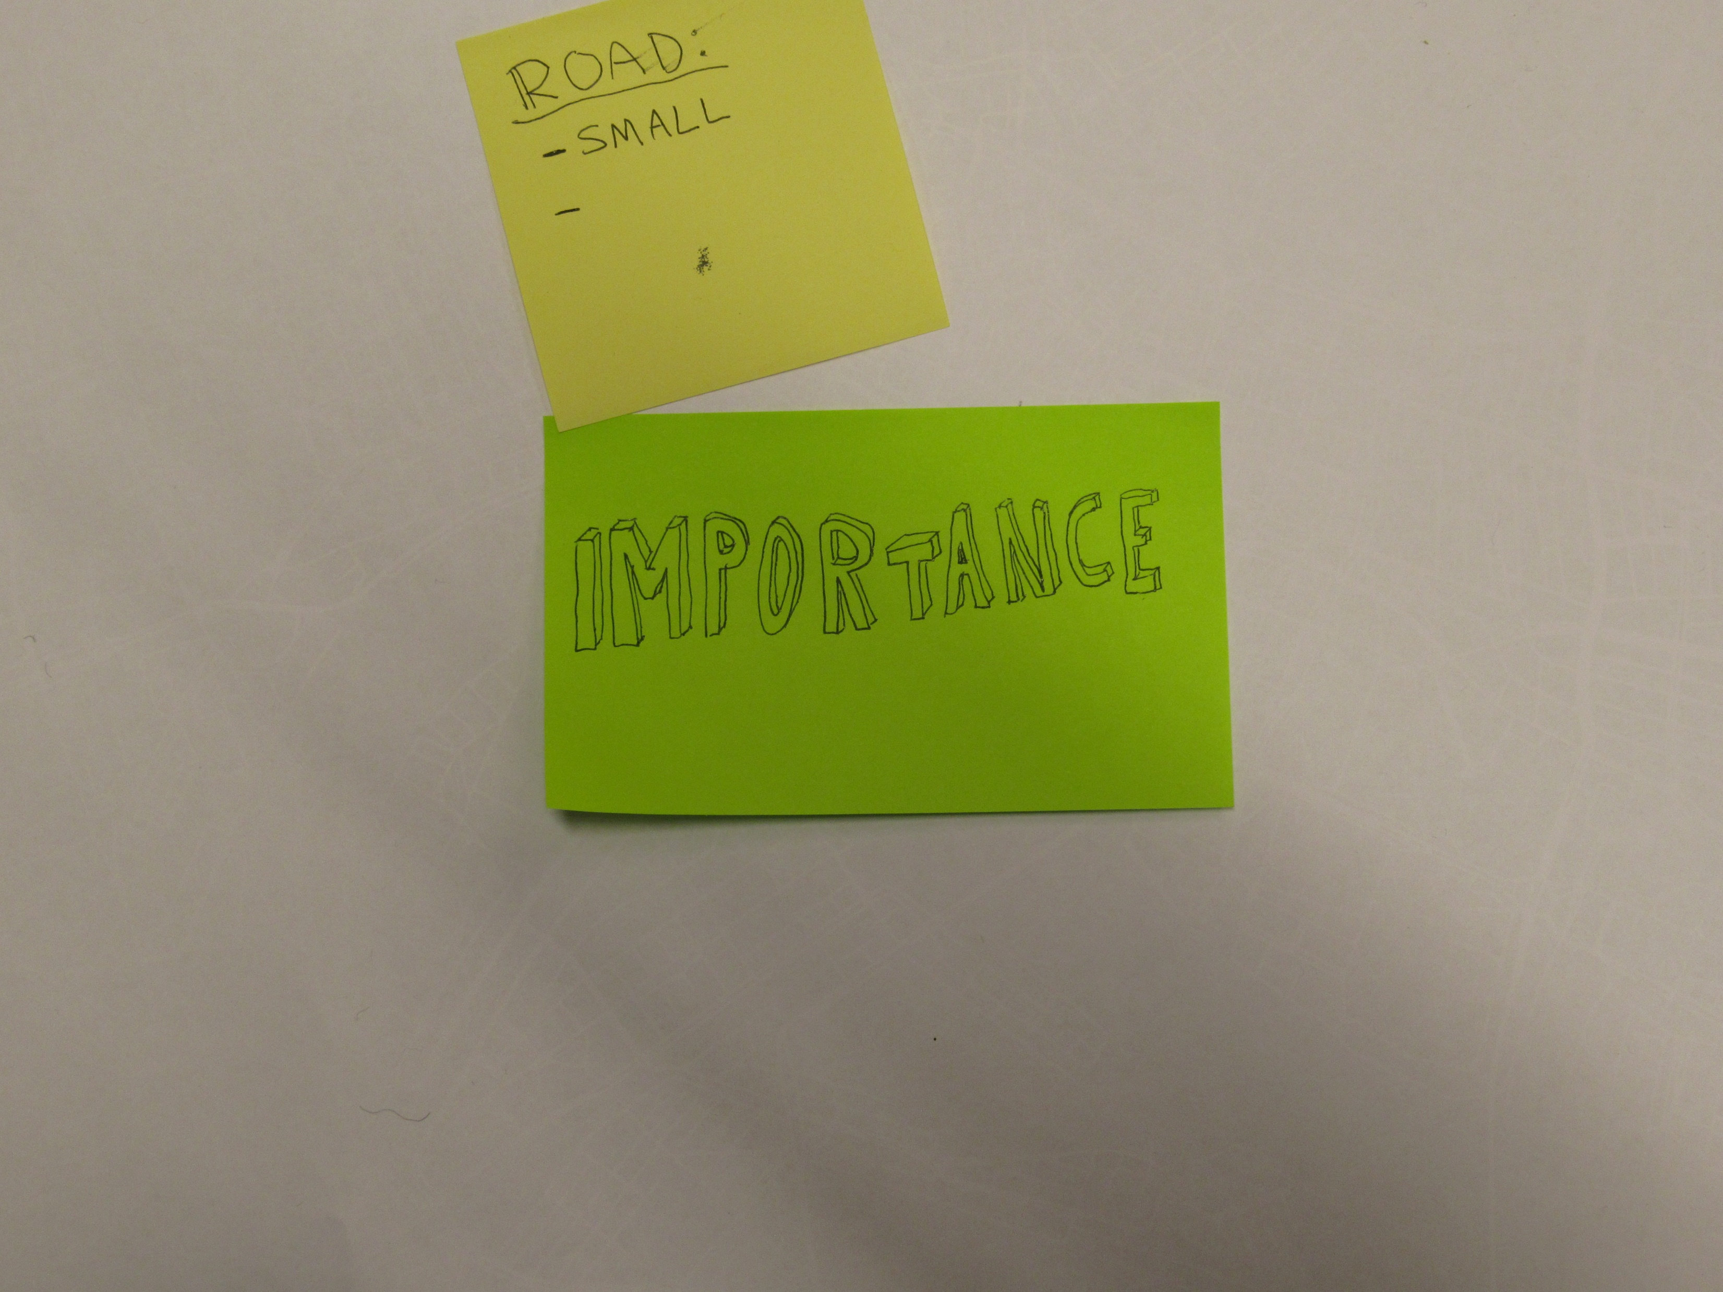

Slide 10
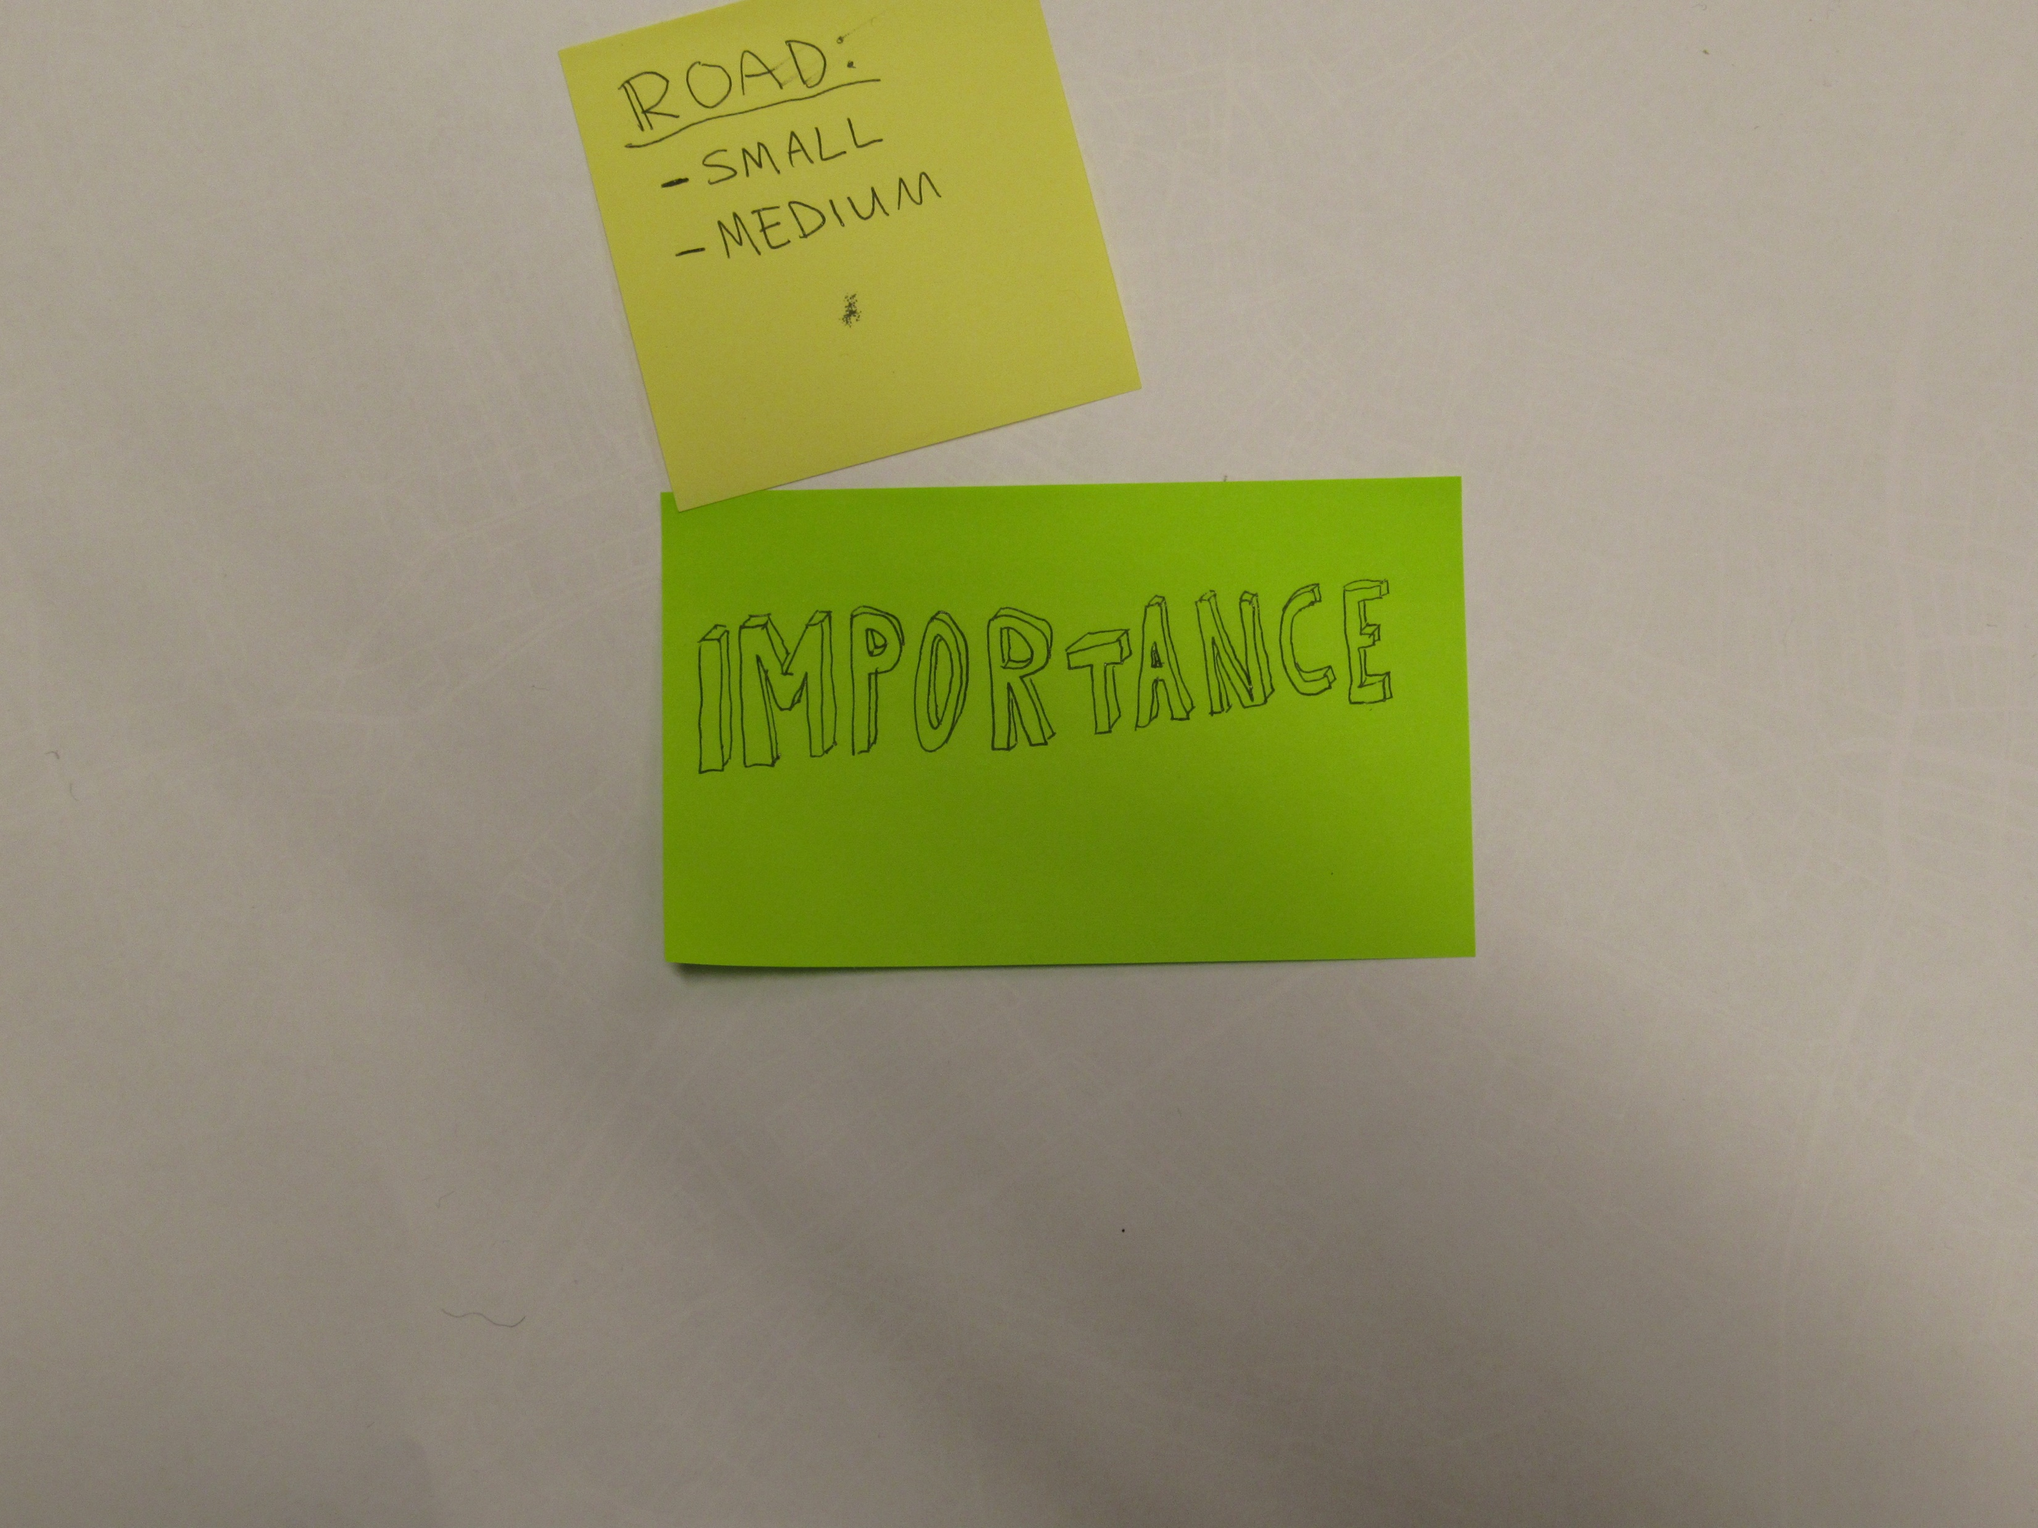

Slide 11
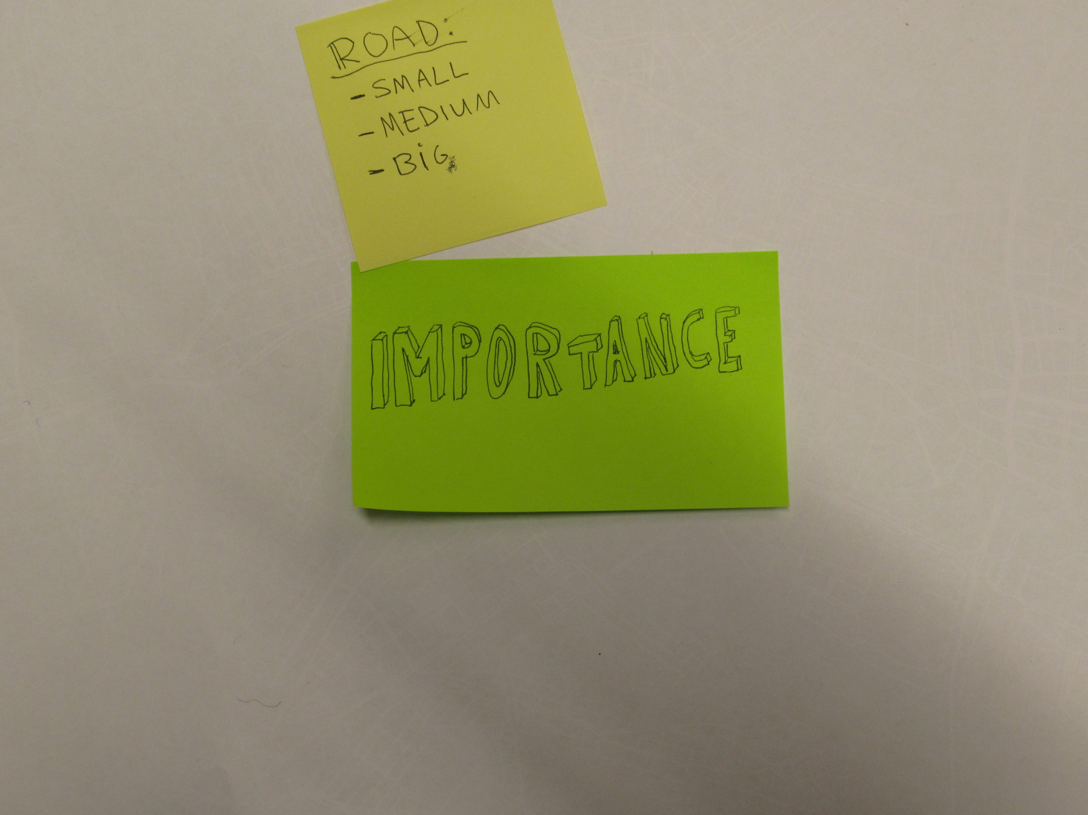

Slide 13
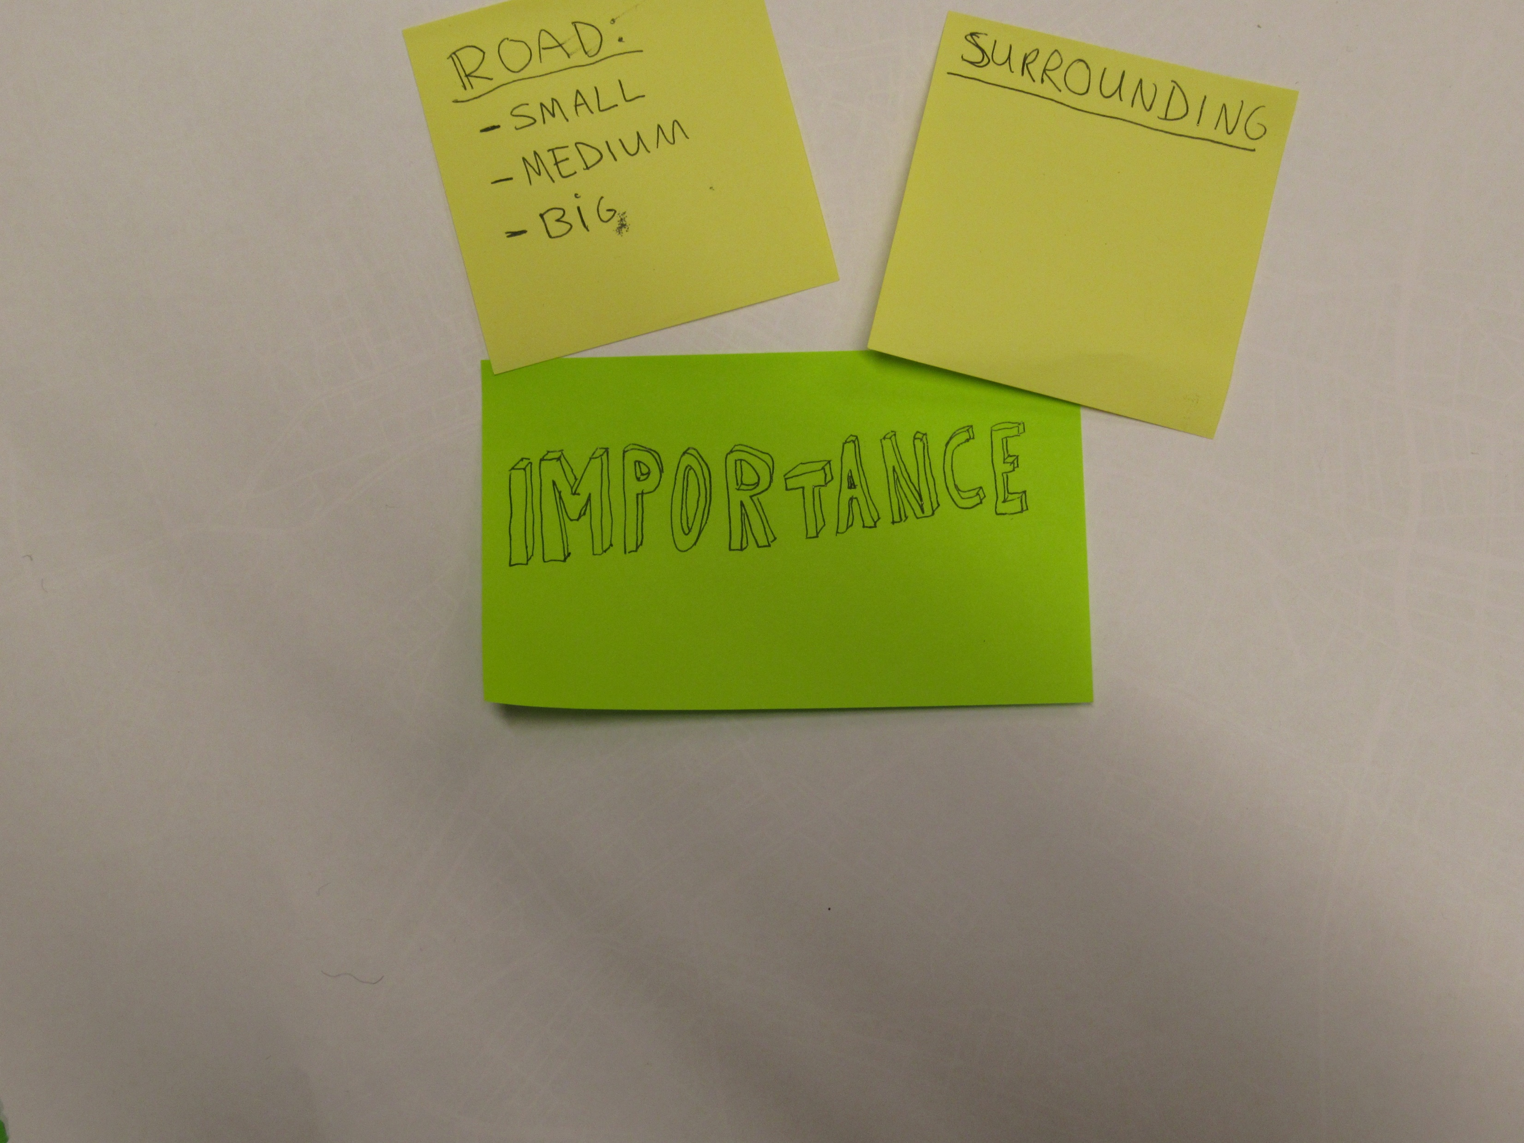

Slide 14
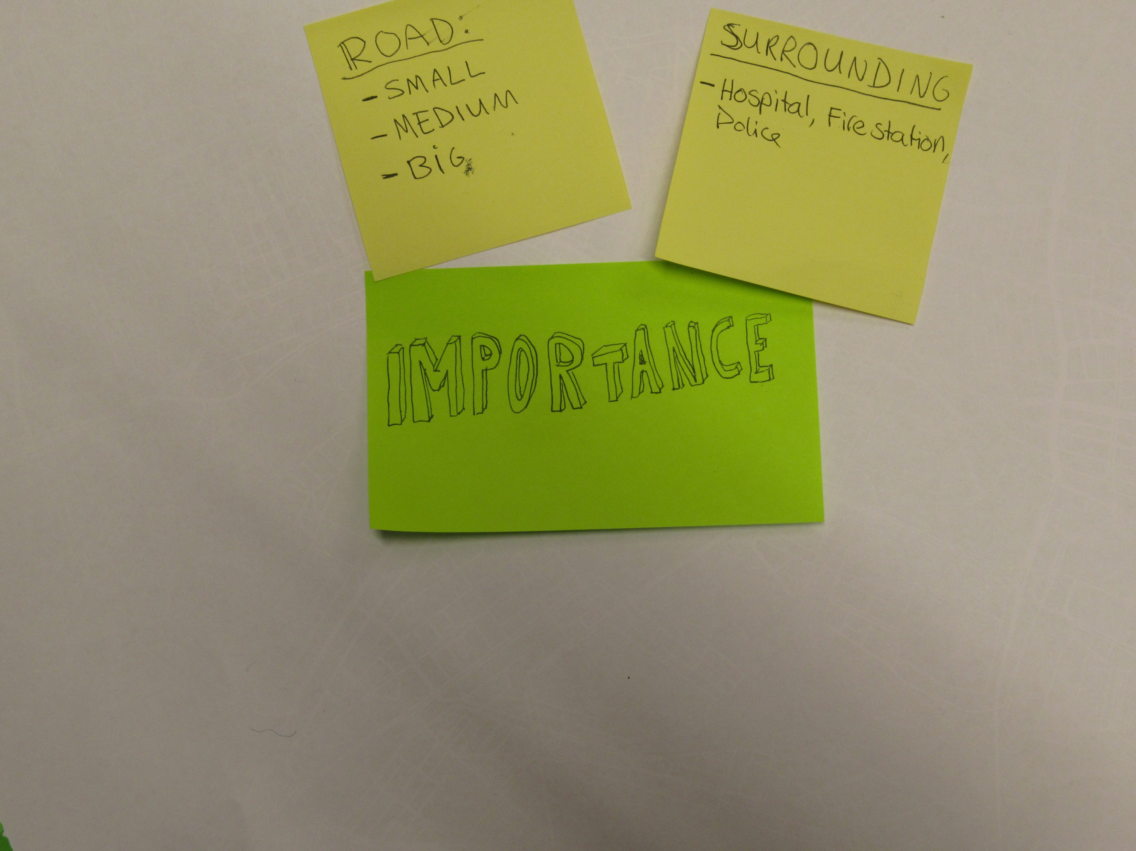

Slide 15
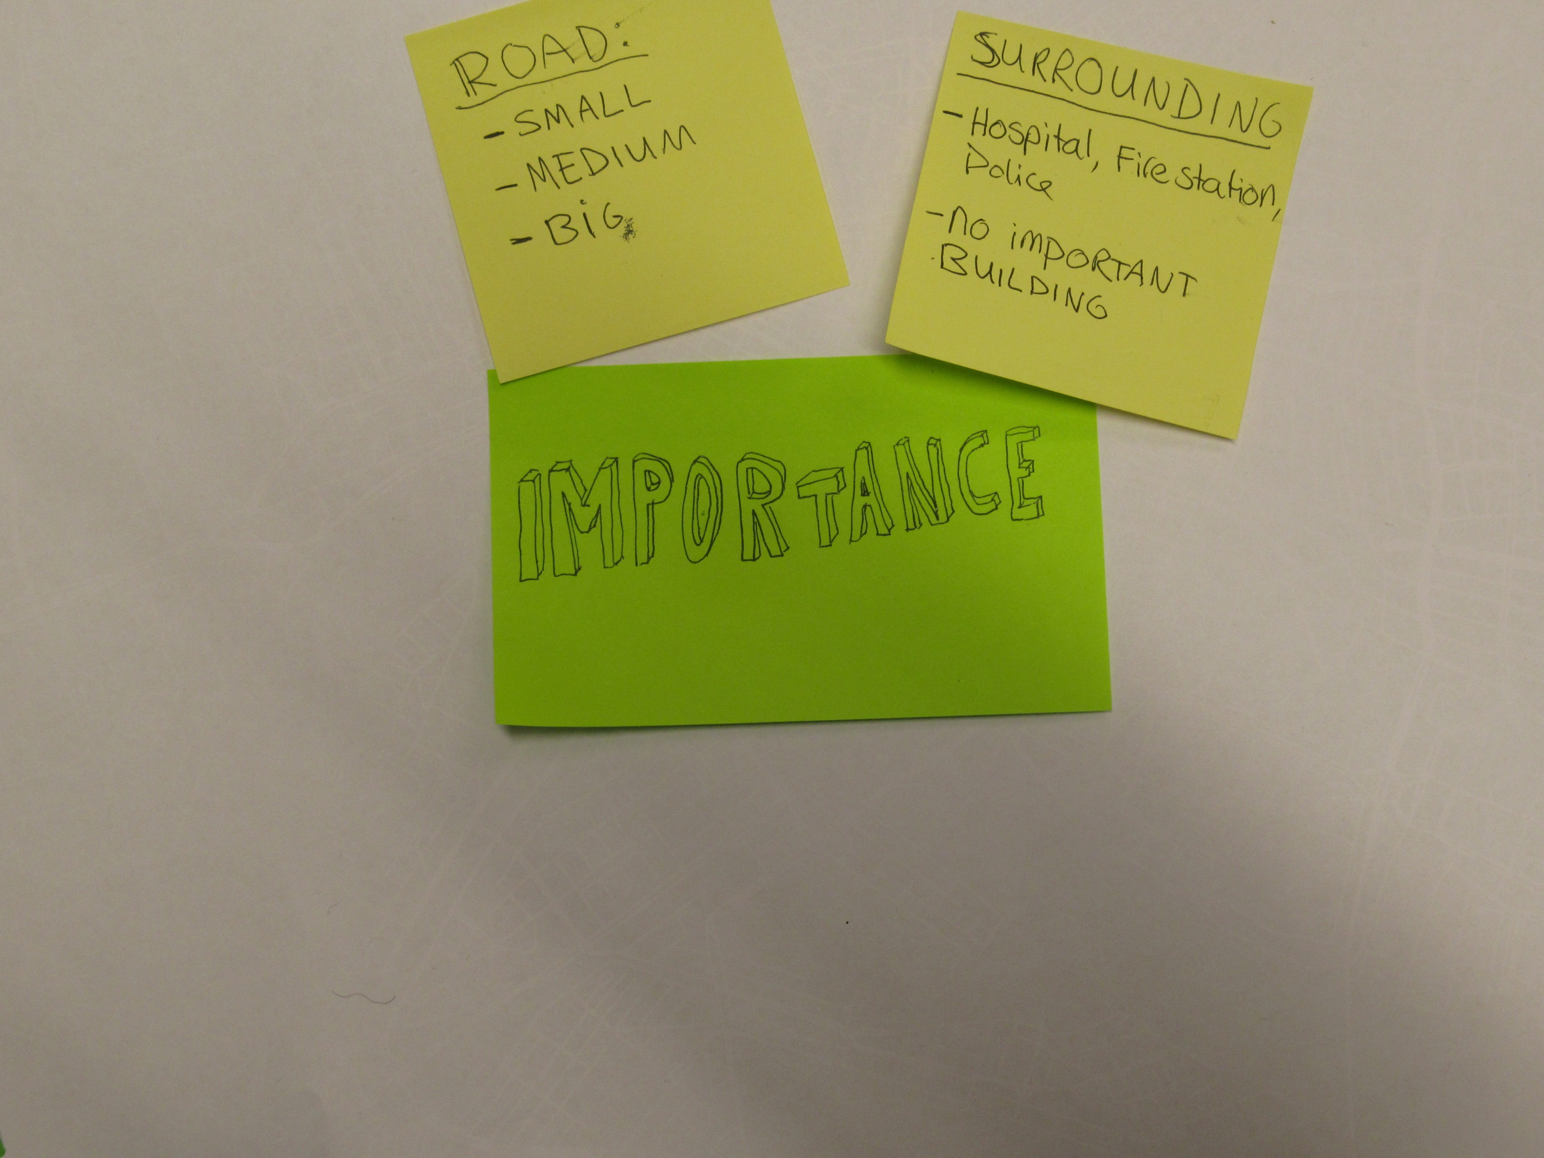

Slide 16
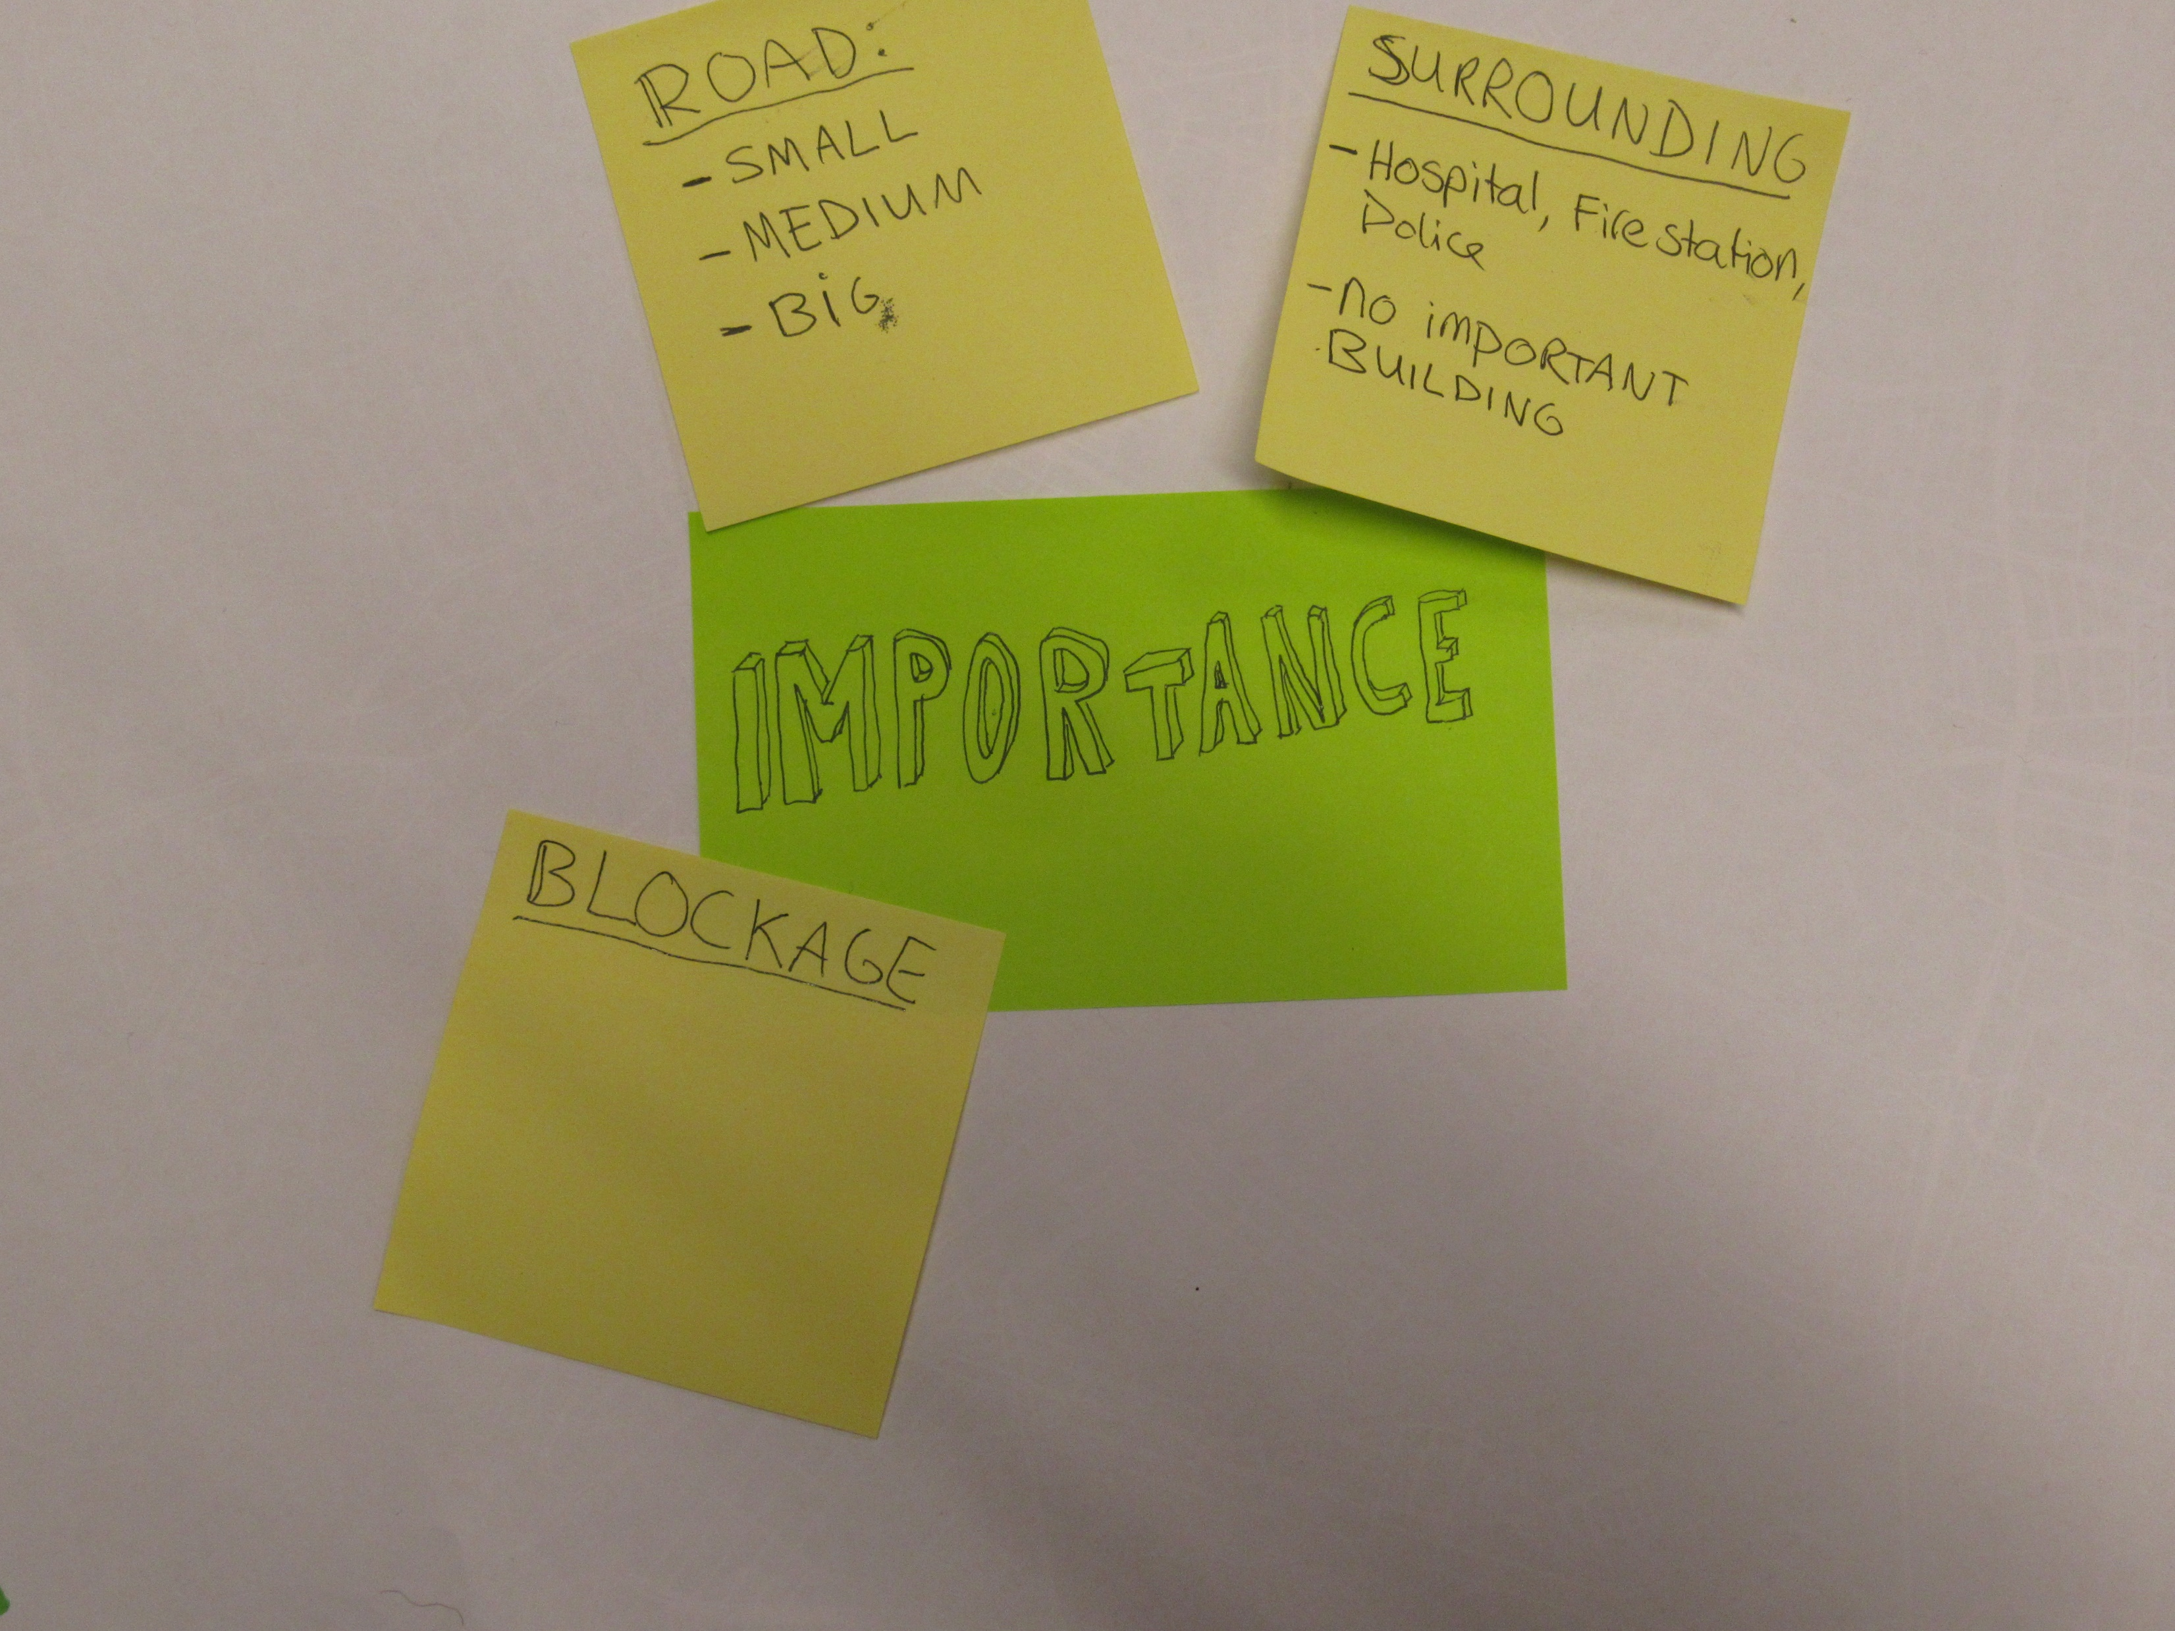

Slide 17
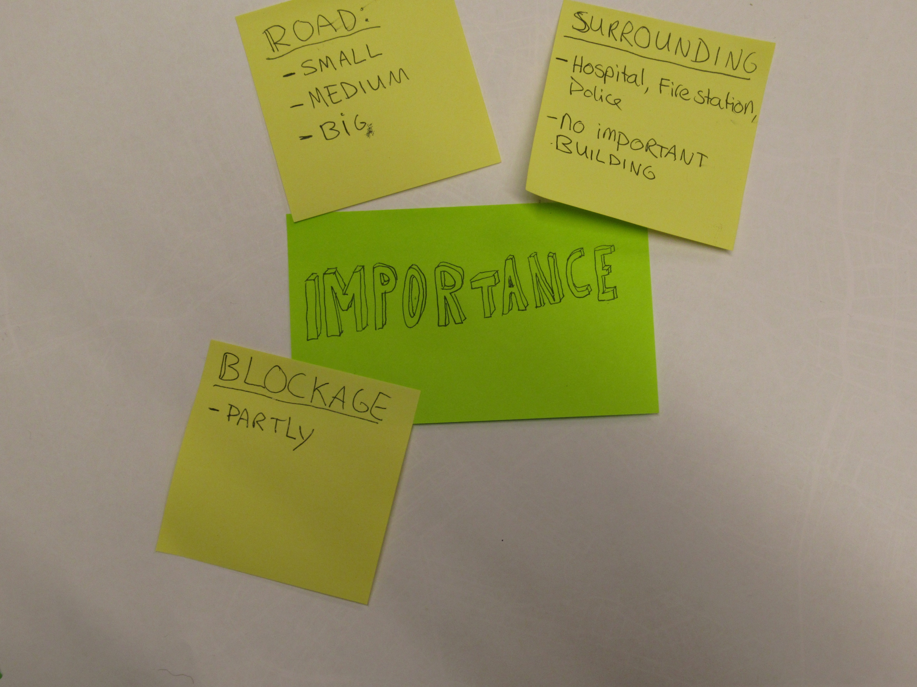

Slide 18
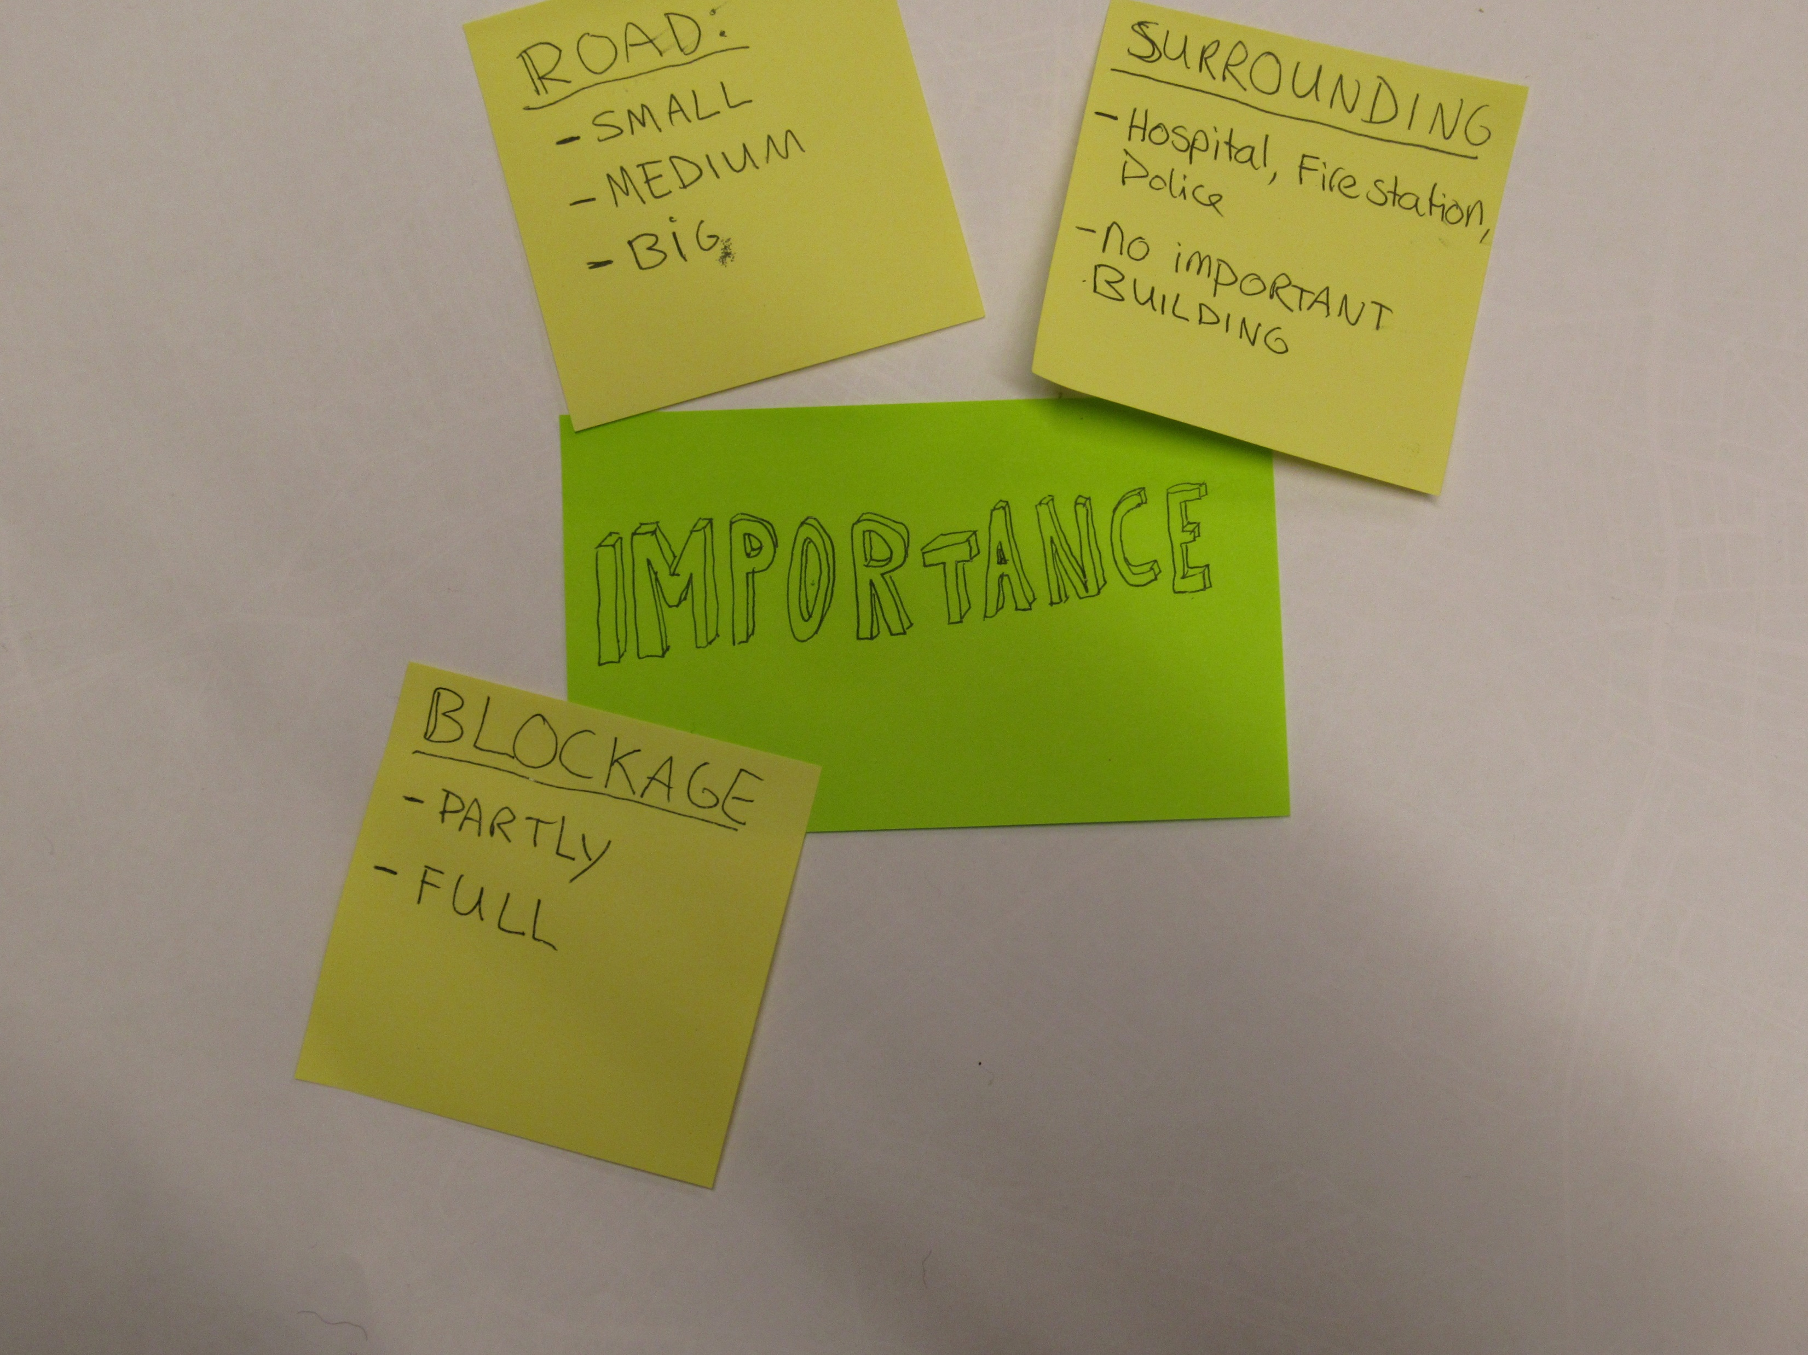

Slide 19
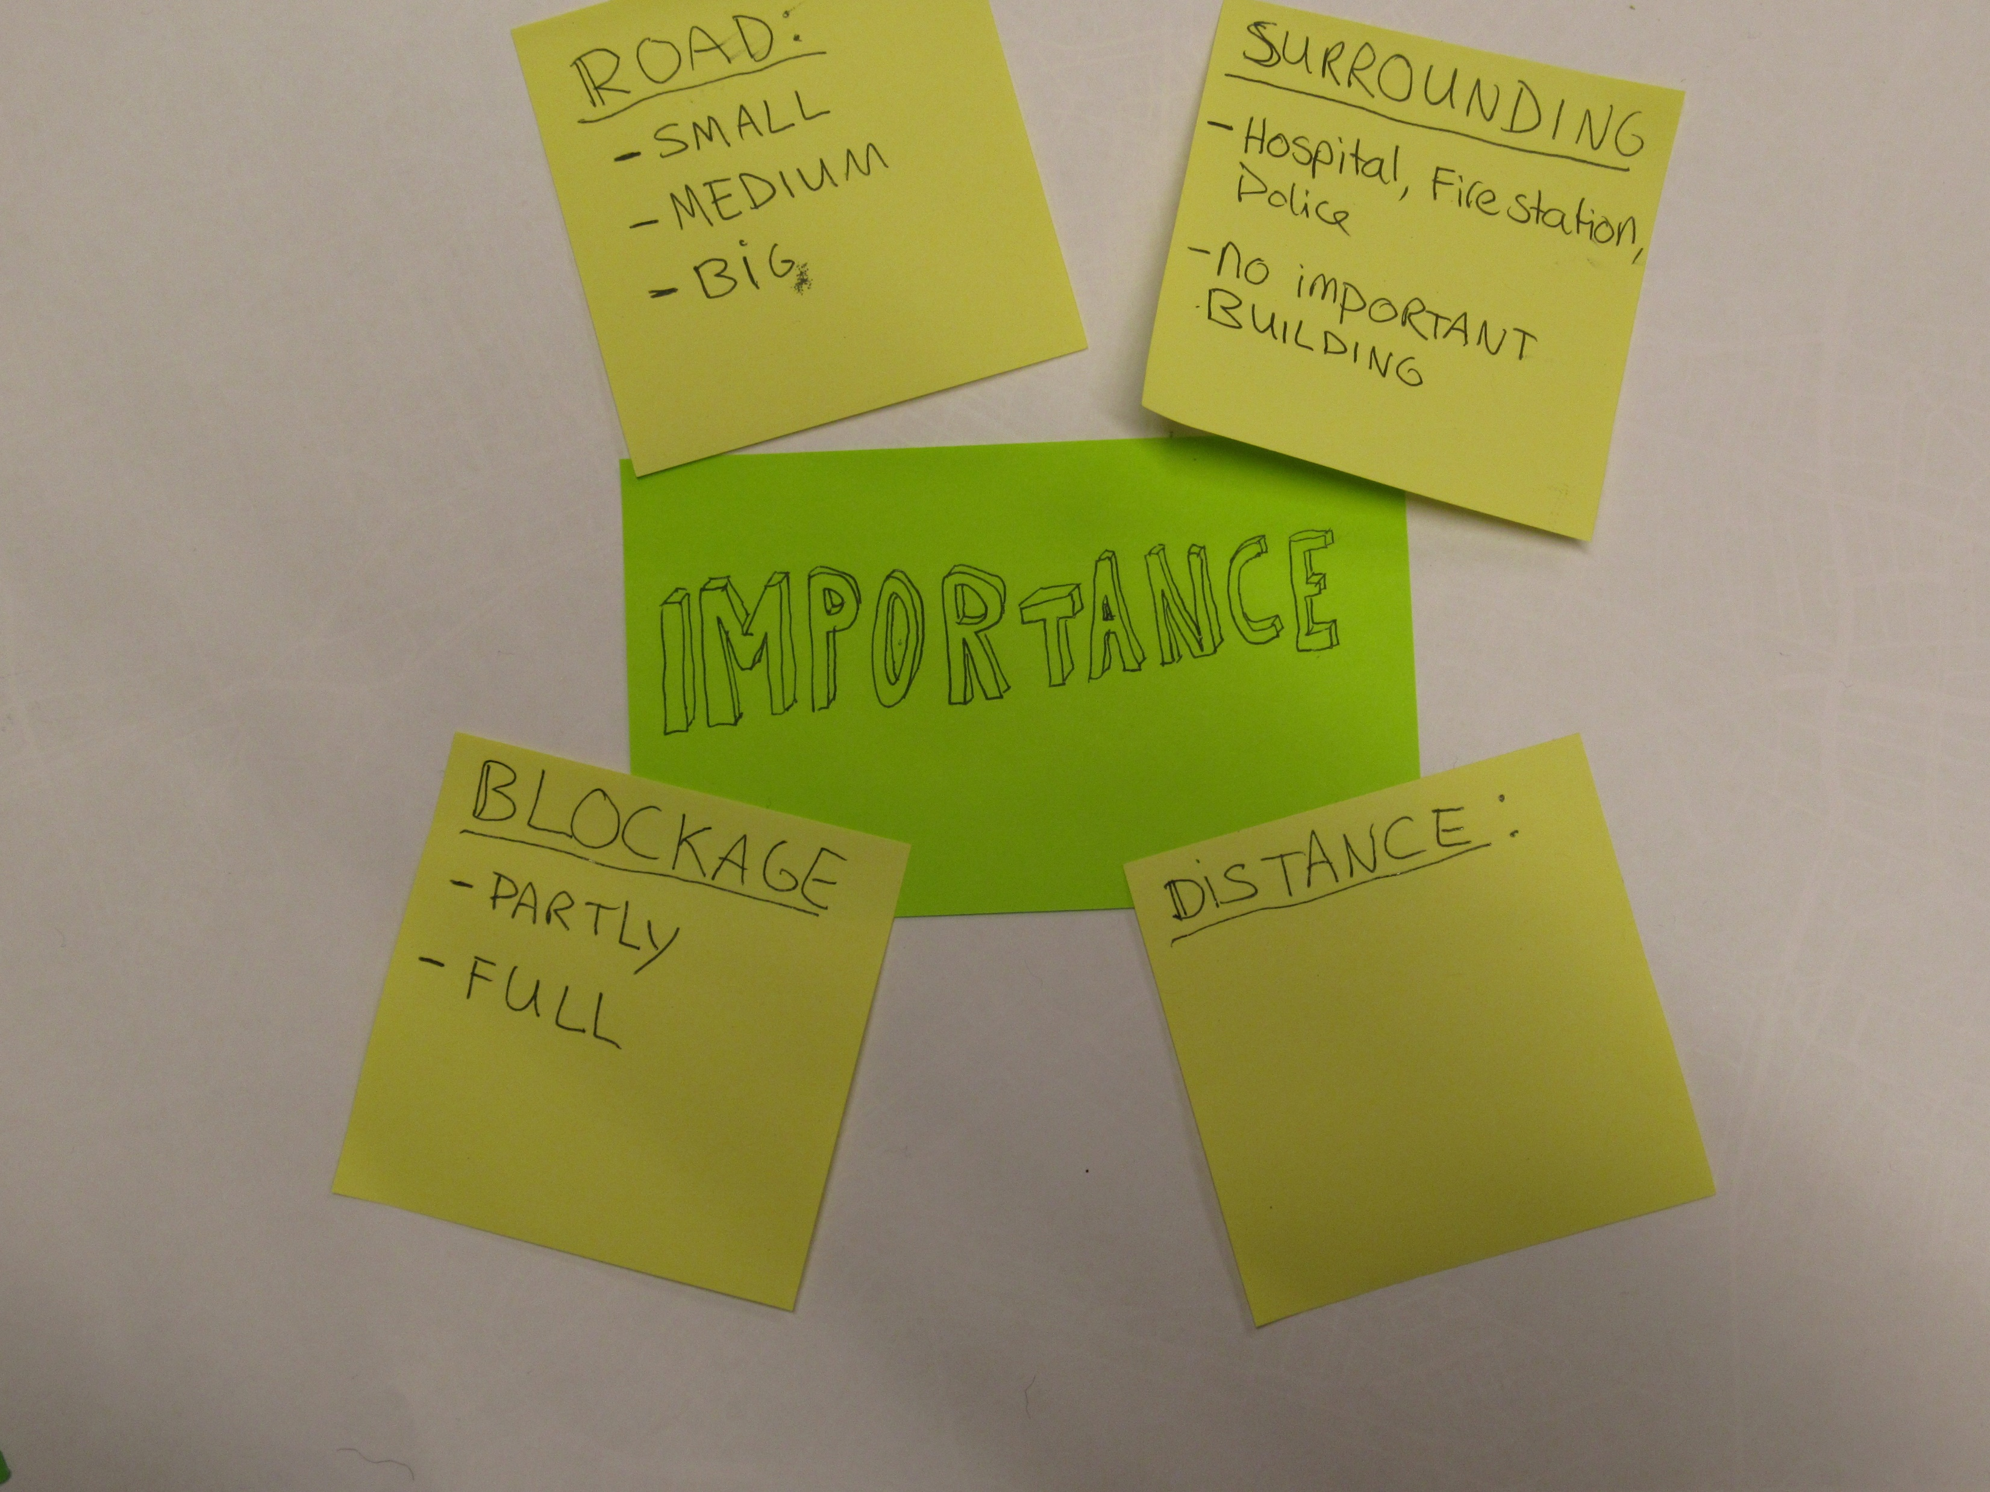

Slide 20
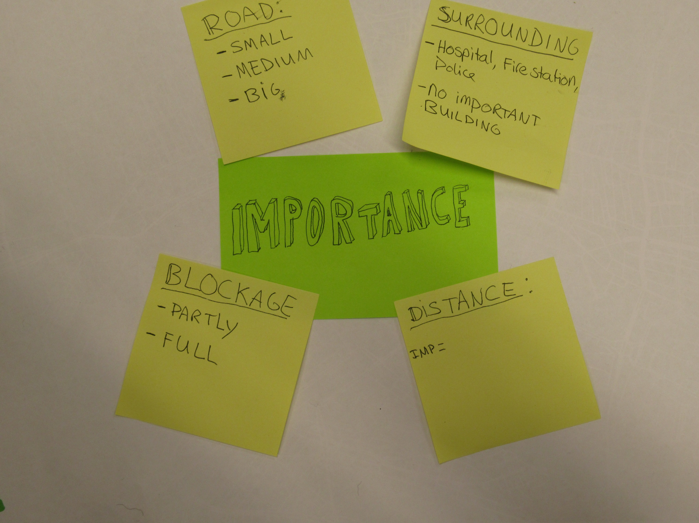

Slide 21
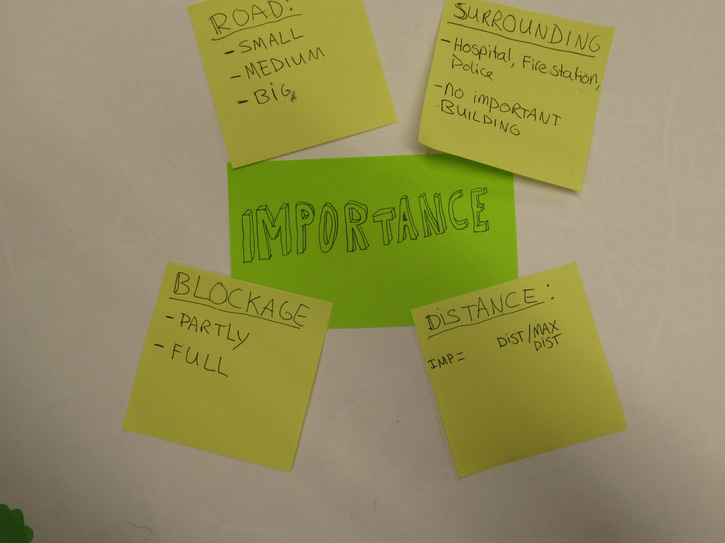

Slide 22


Slide 23
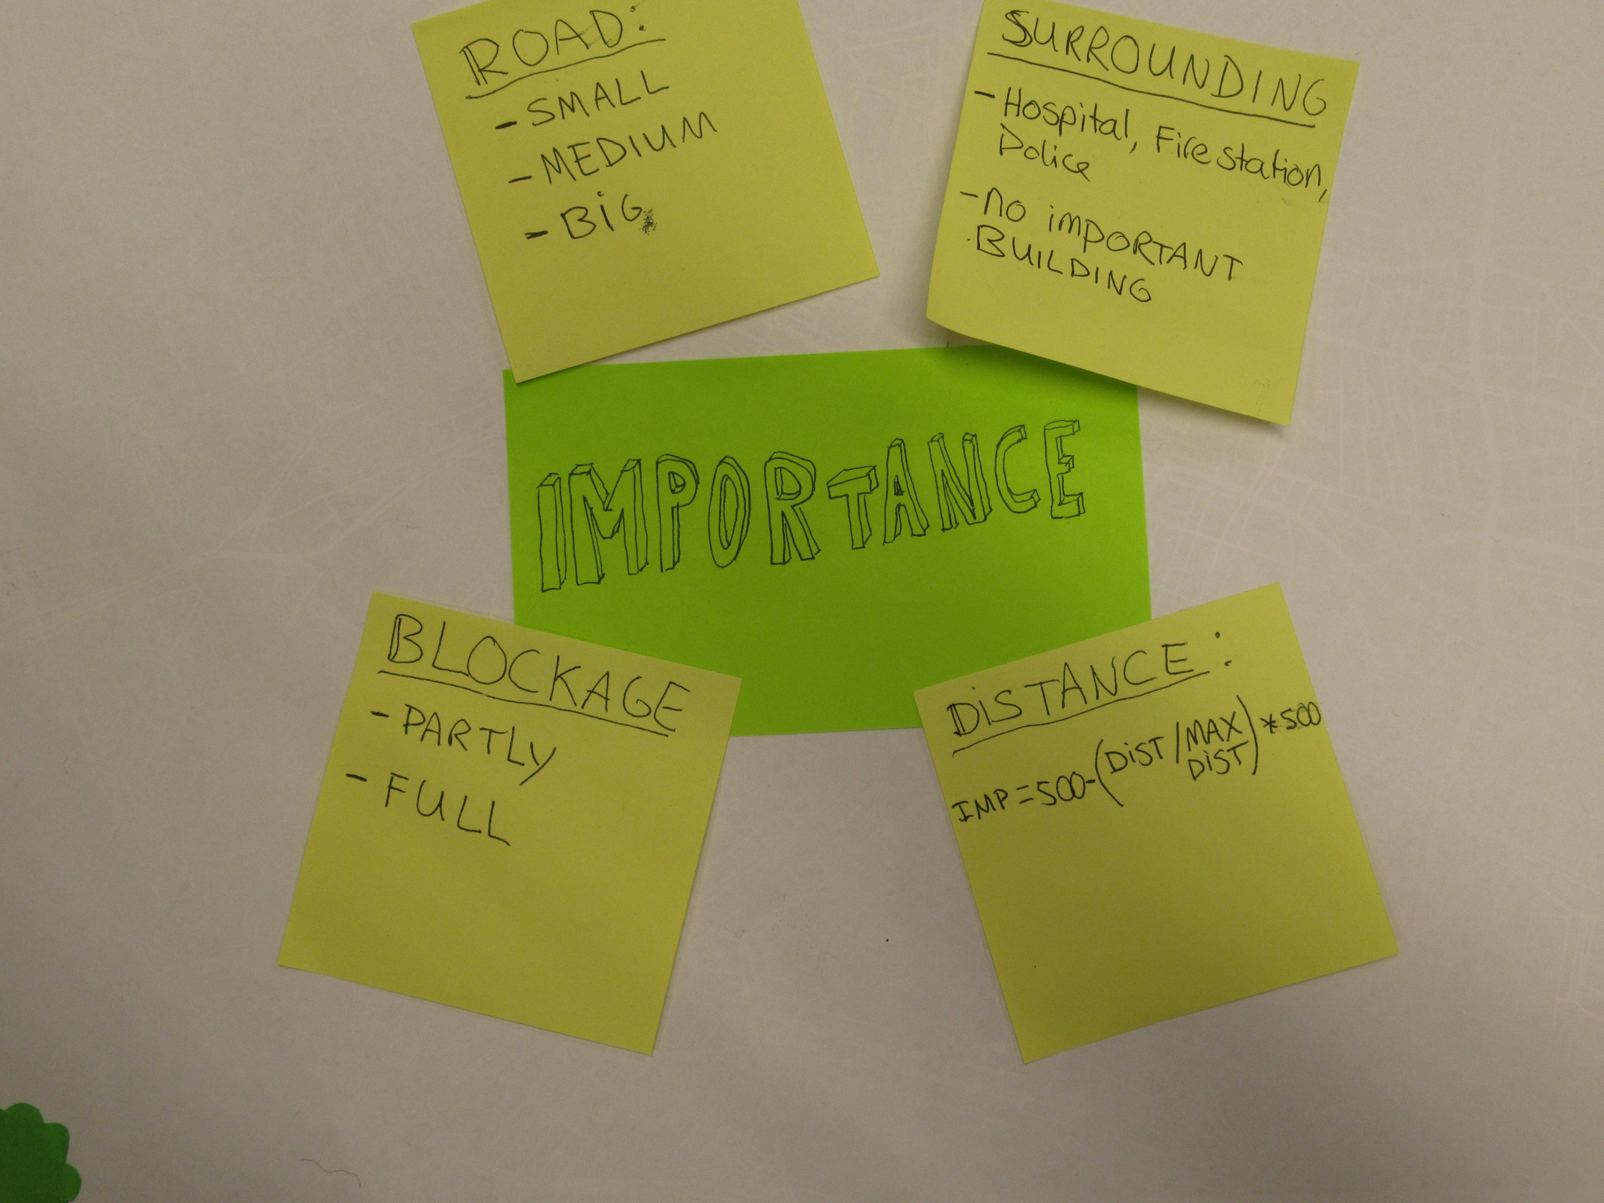

Slide 24
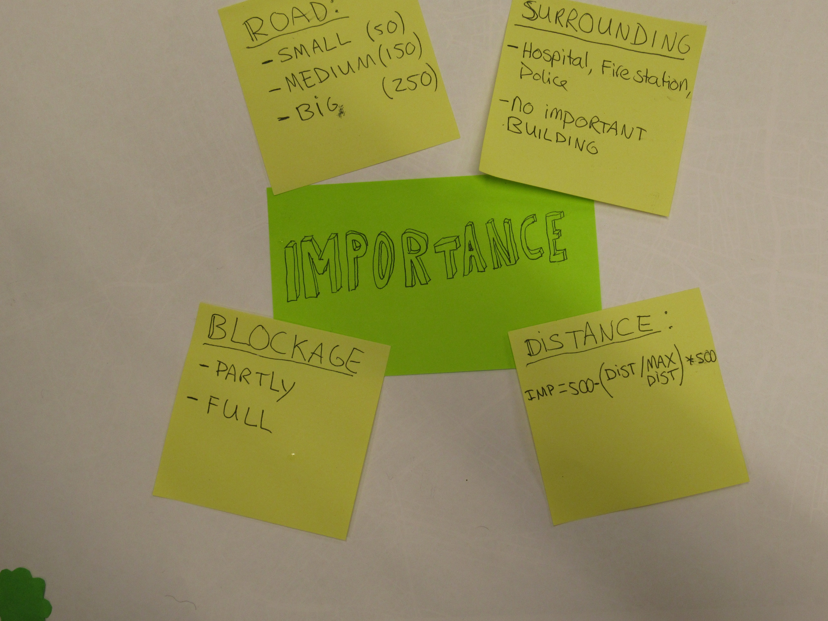

Slide 25
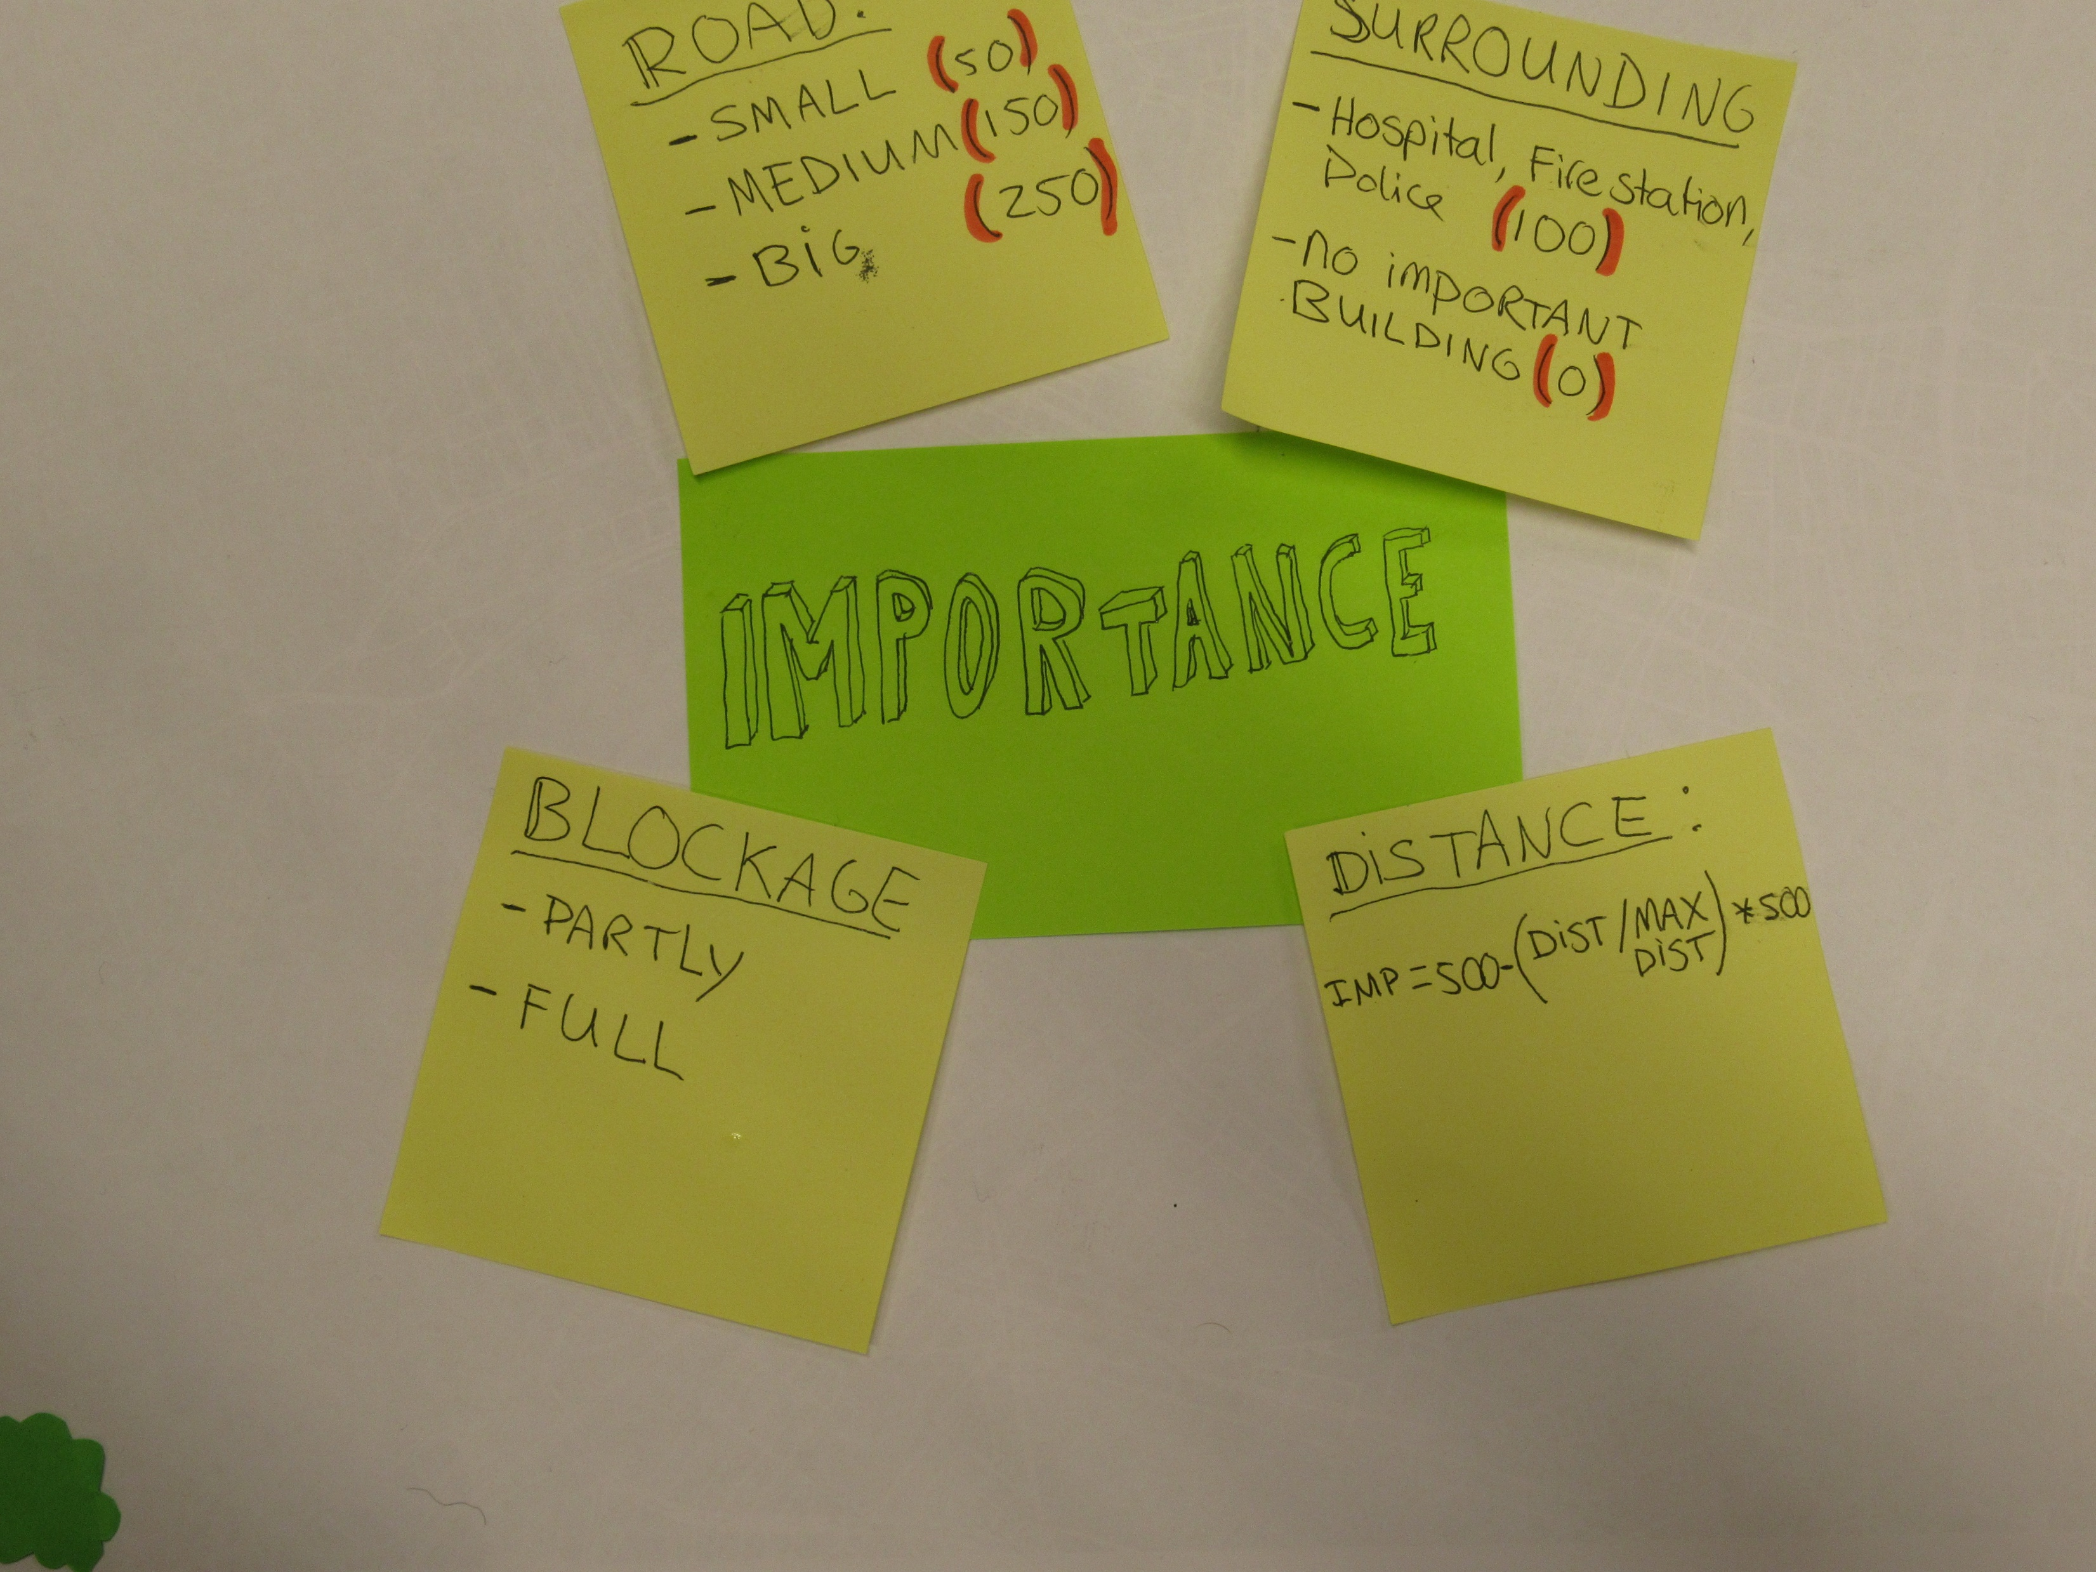

Slide 26
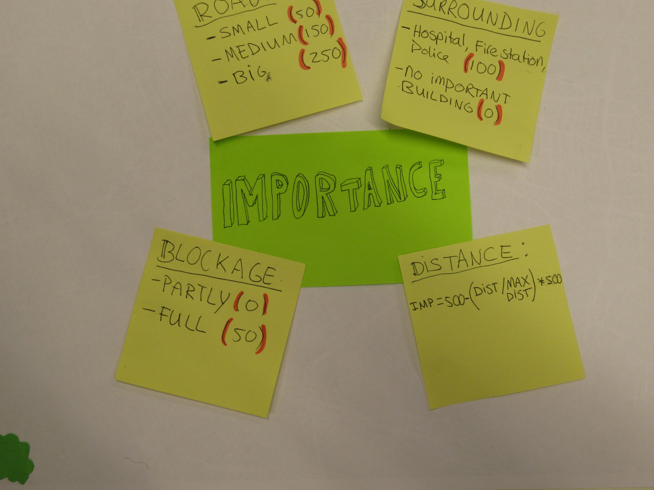

Slide 27
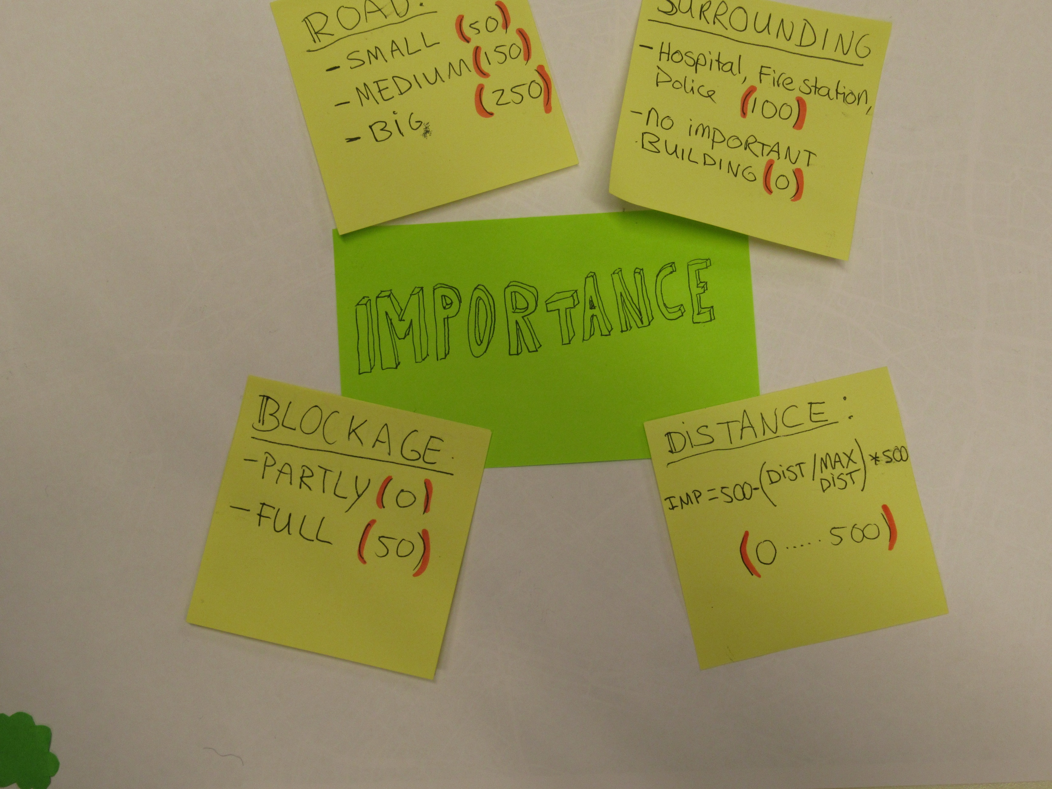

Slide 28
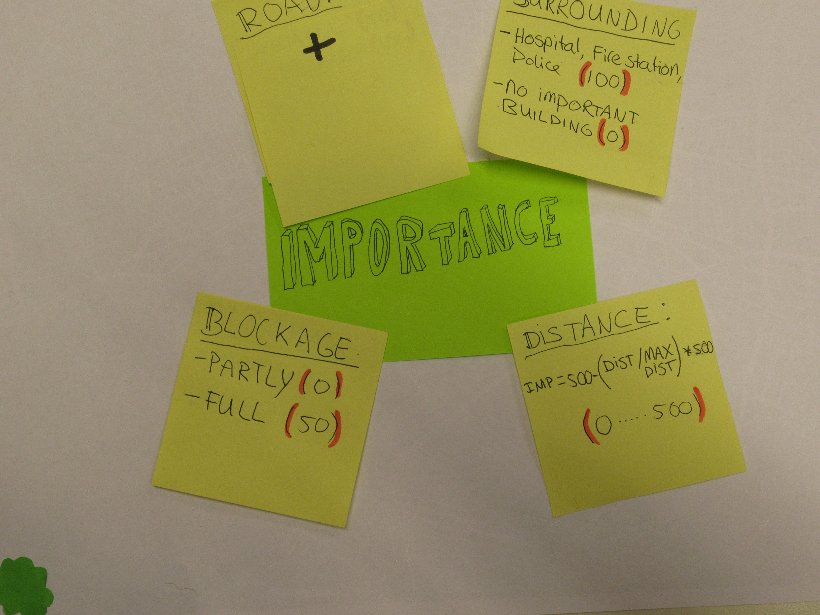

Slide 29
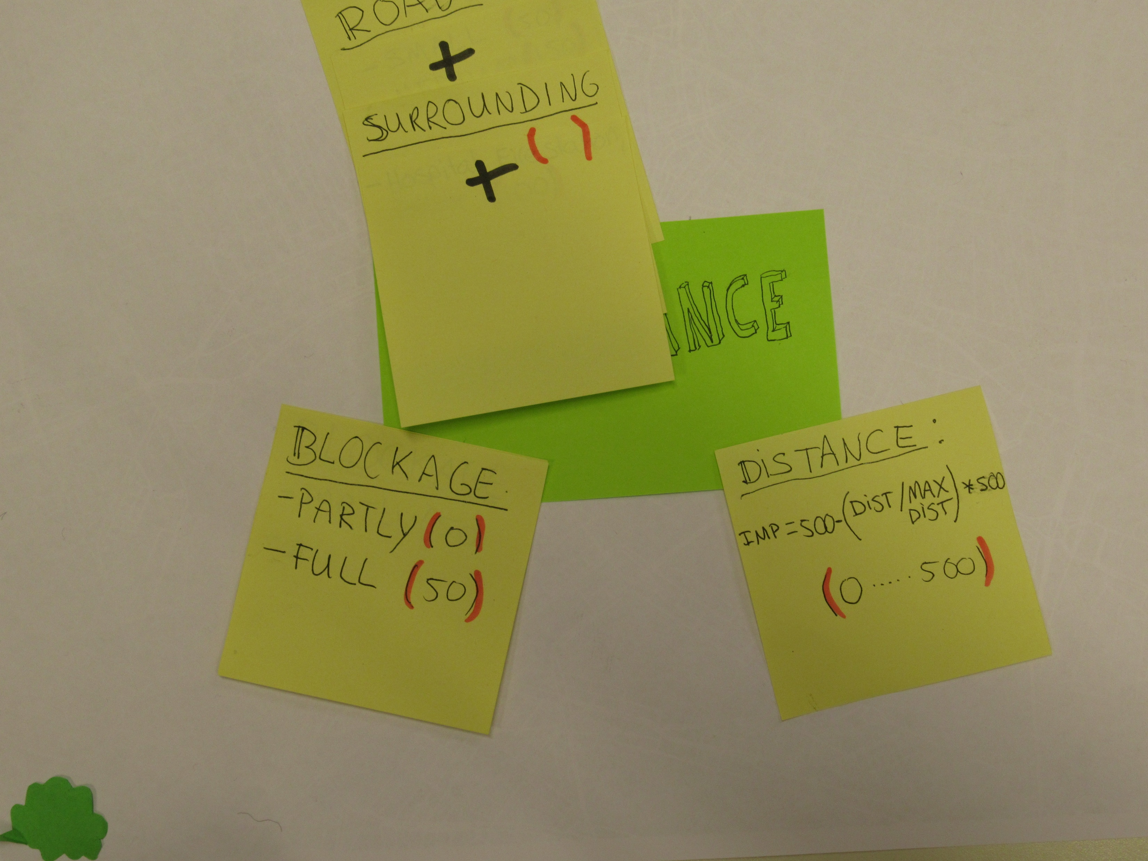

Slide 30
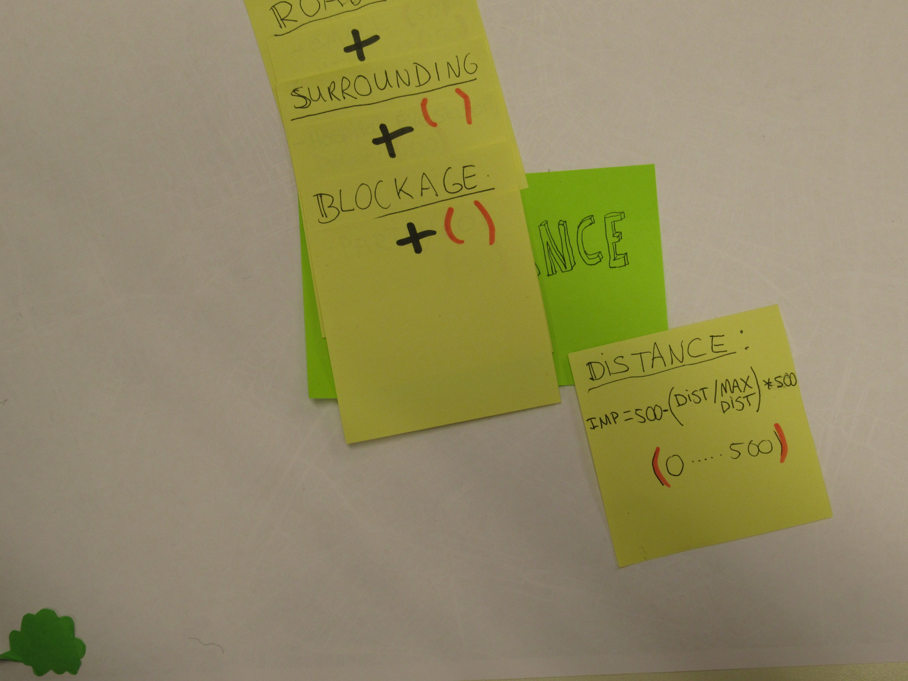

Slide 31
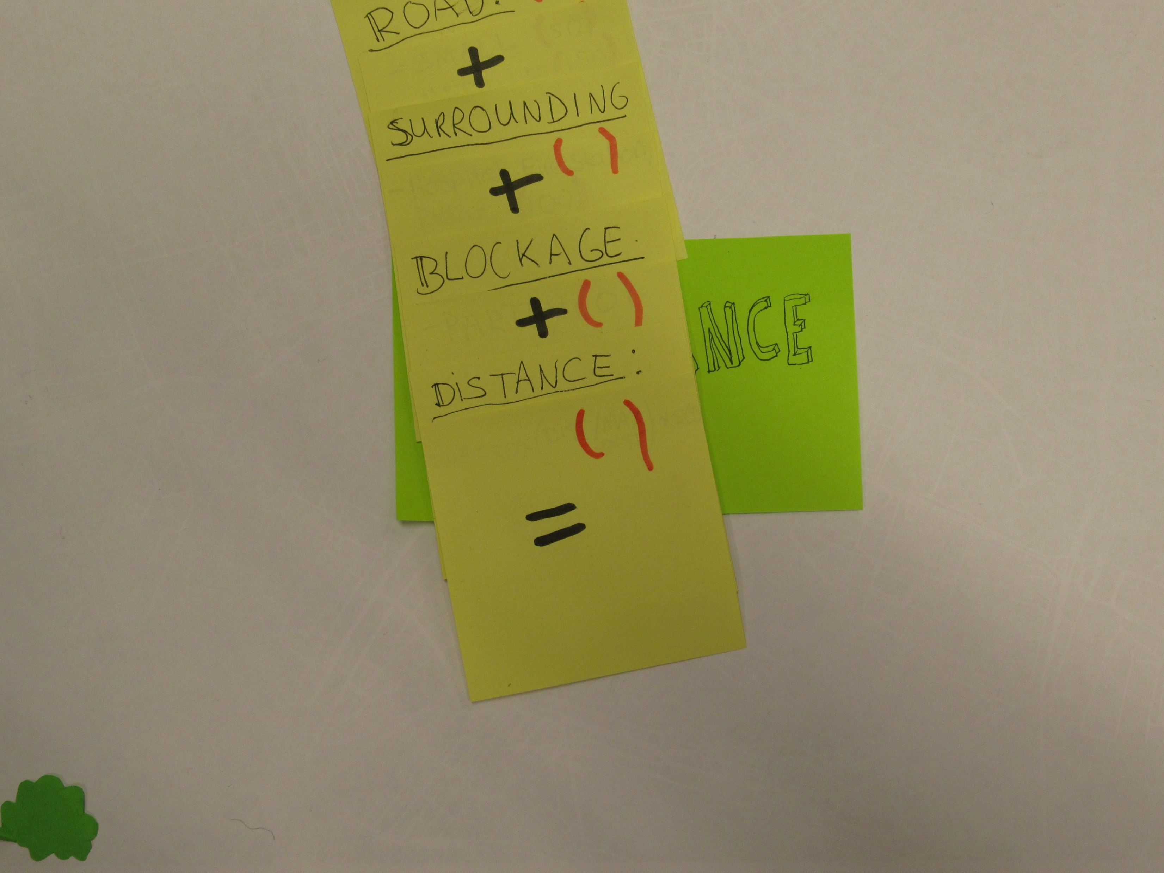

Slide 32
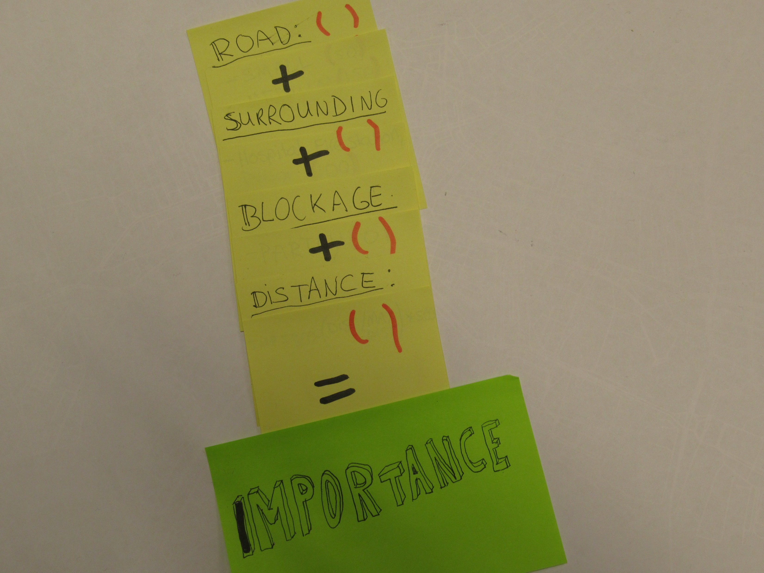

Slide 33
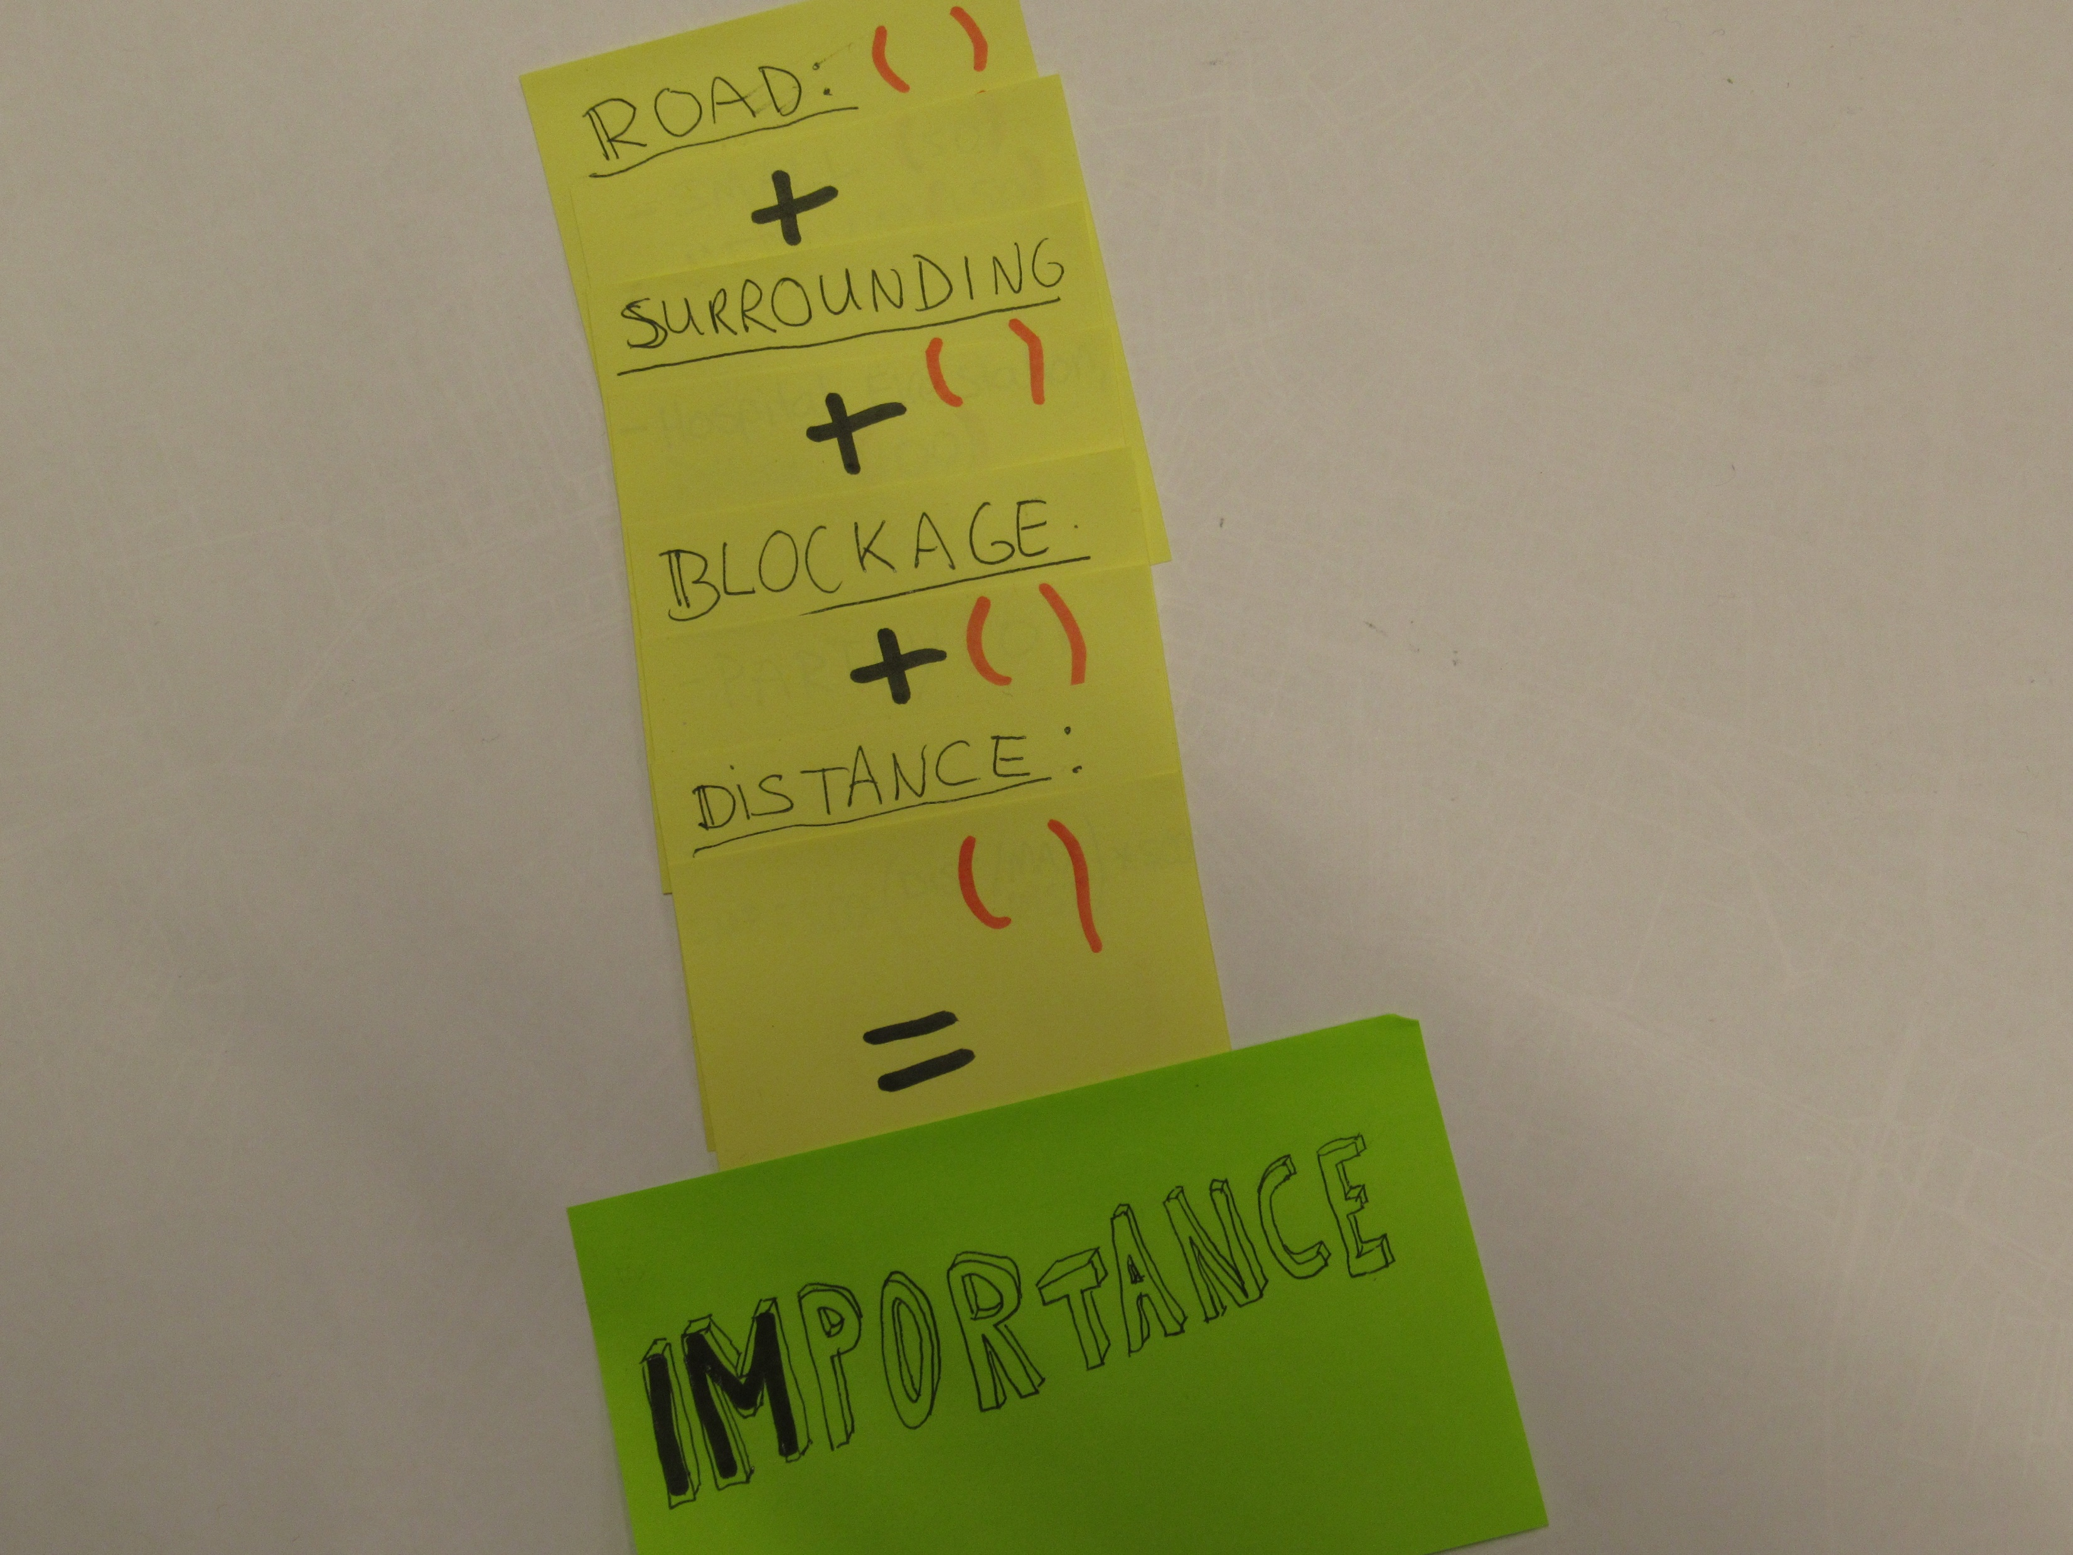

Slide 34
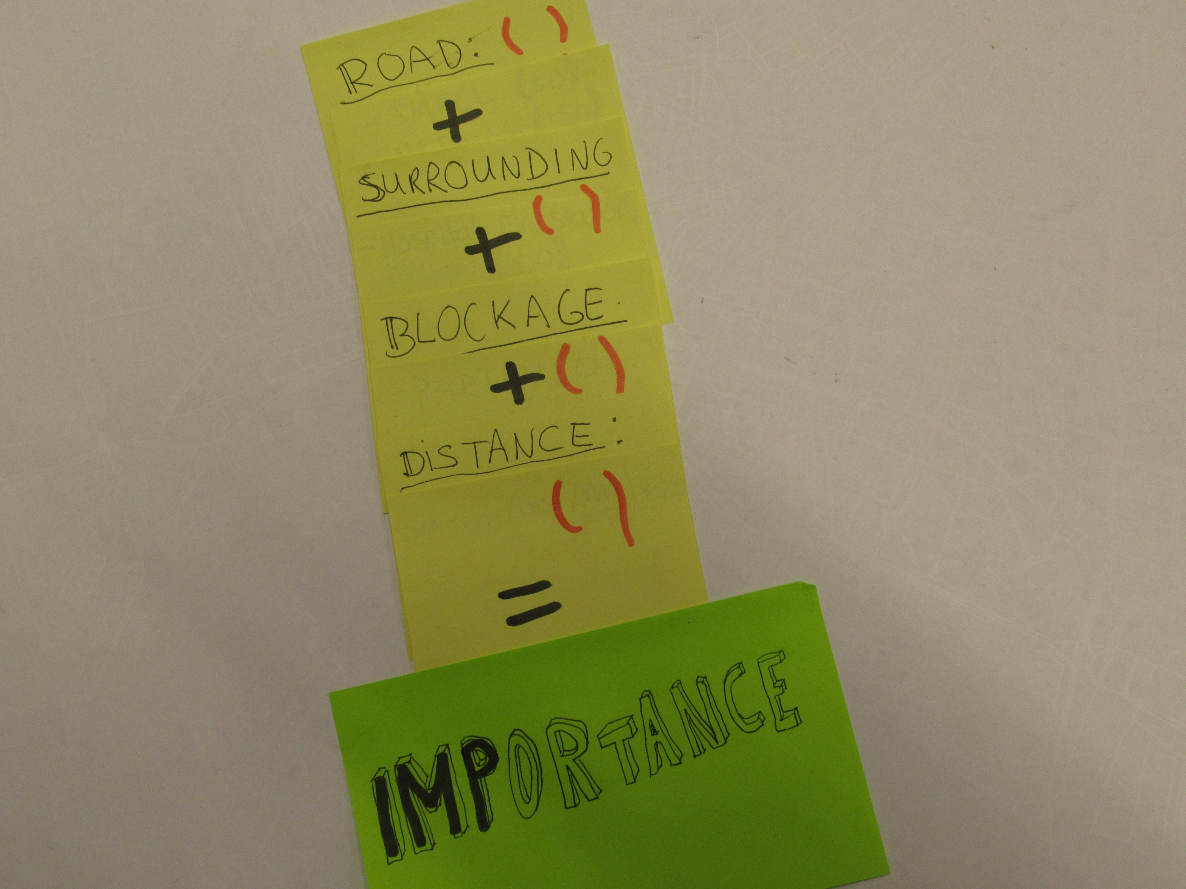

Slide 35
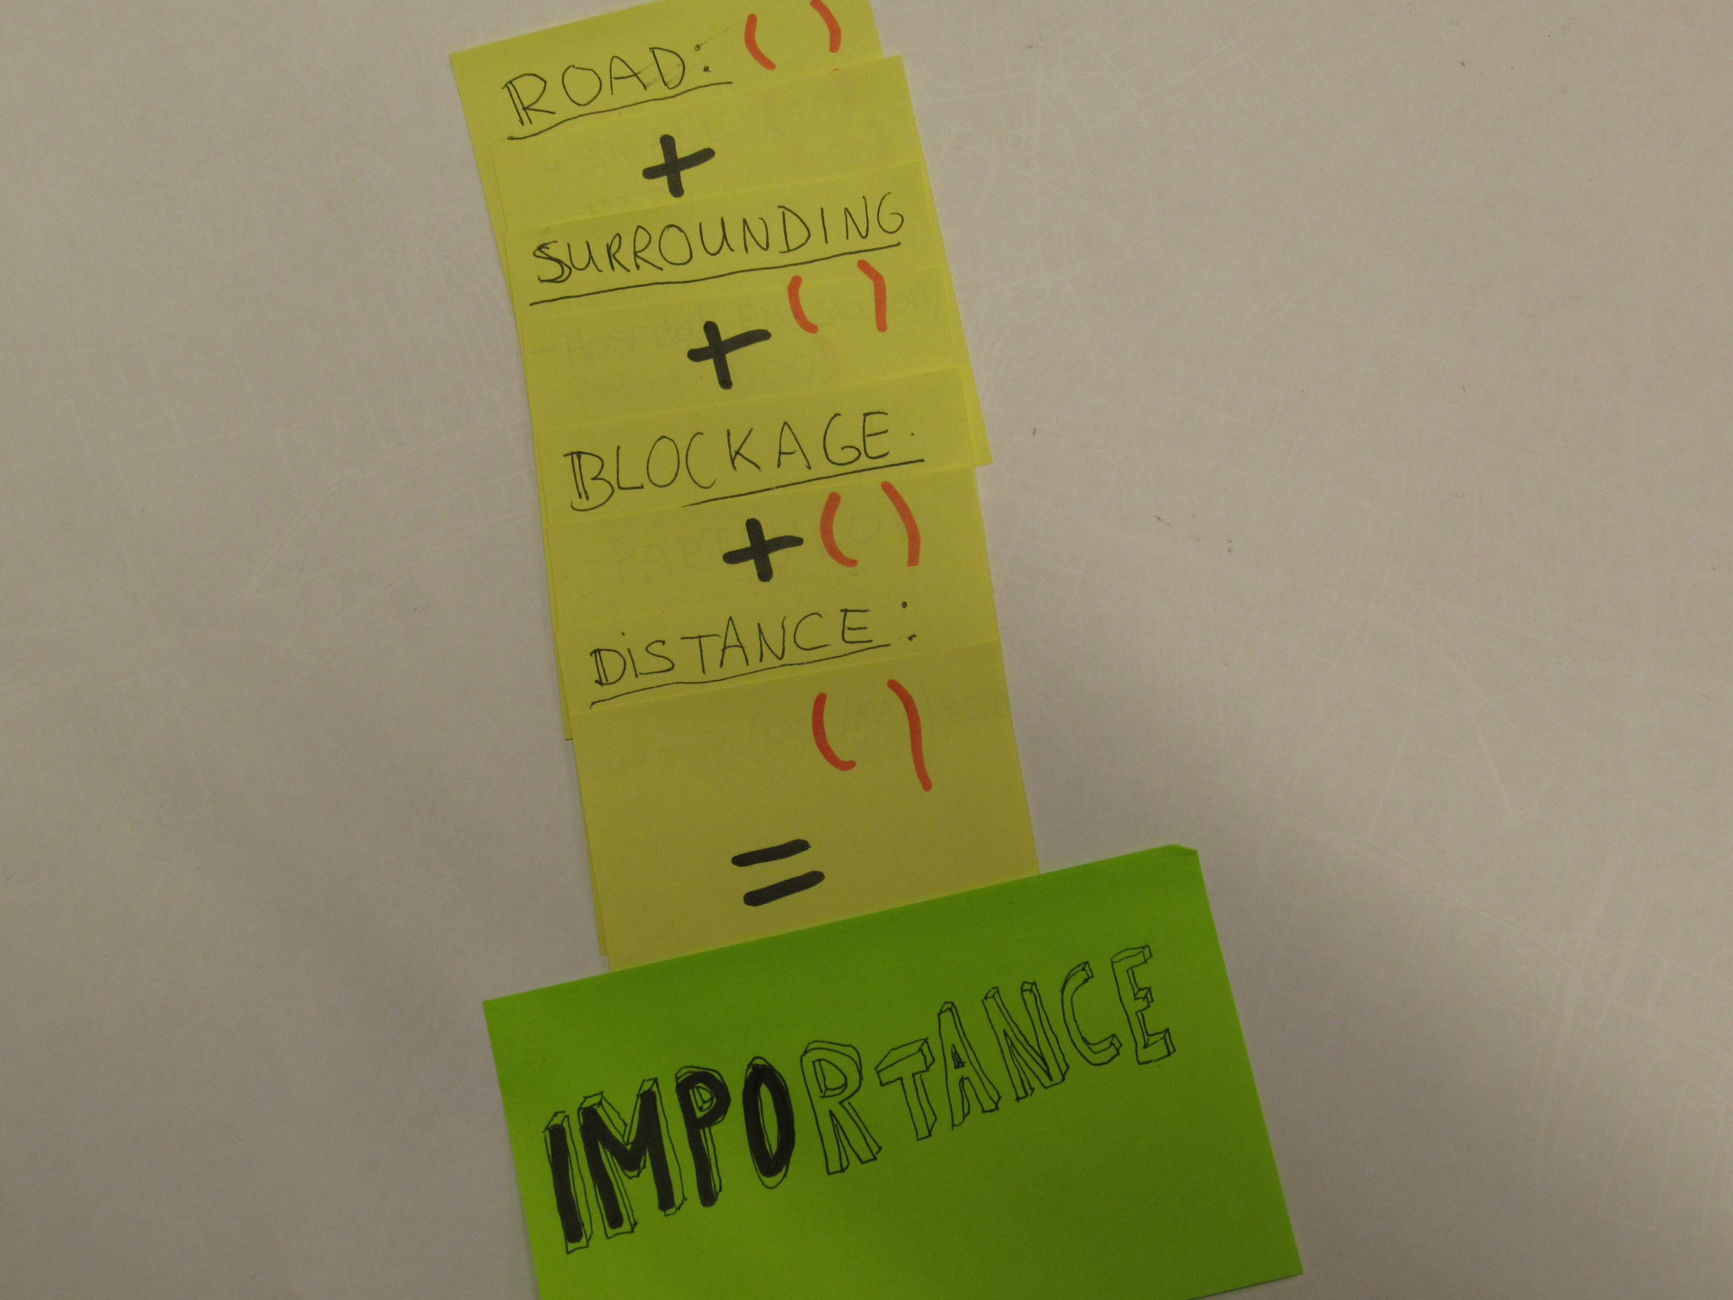

Slide 36
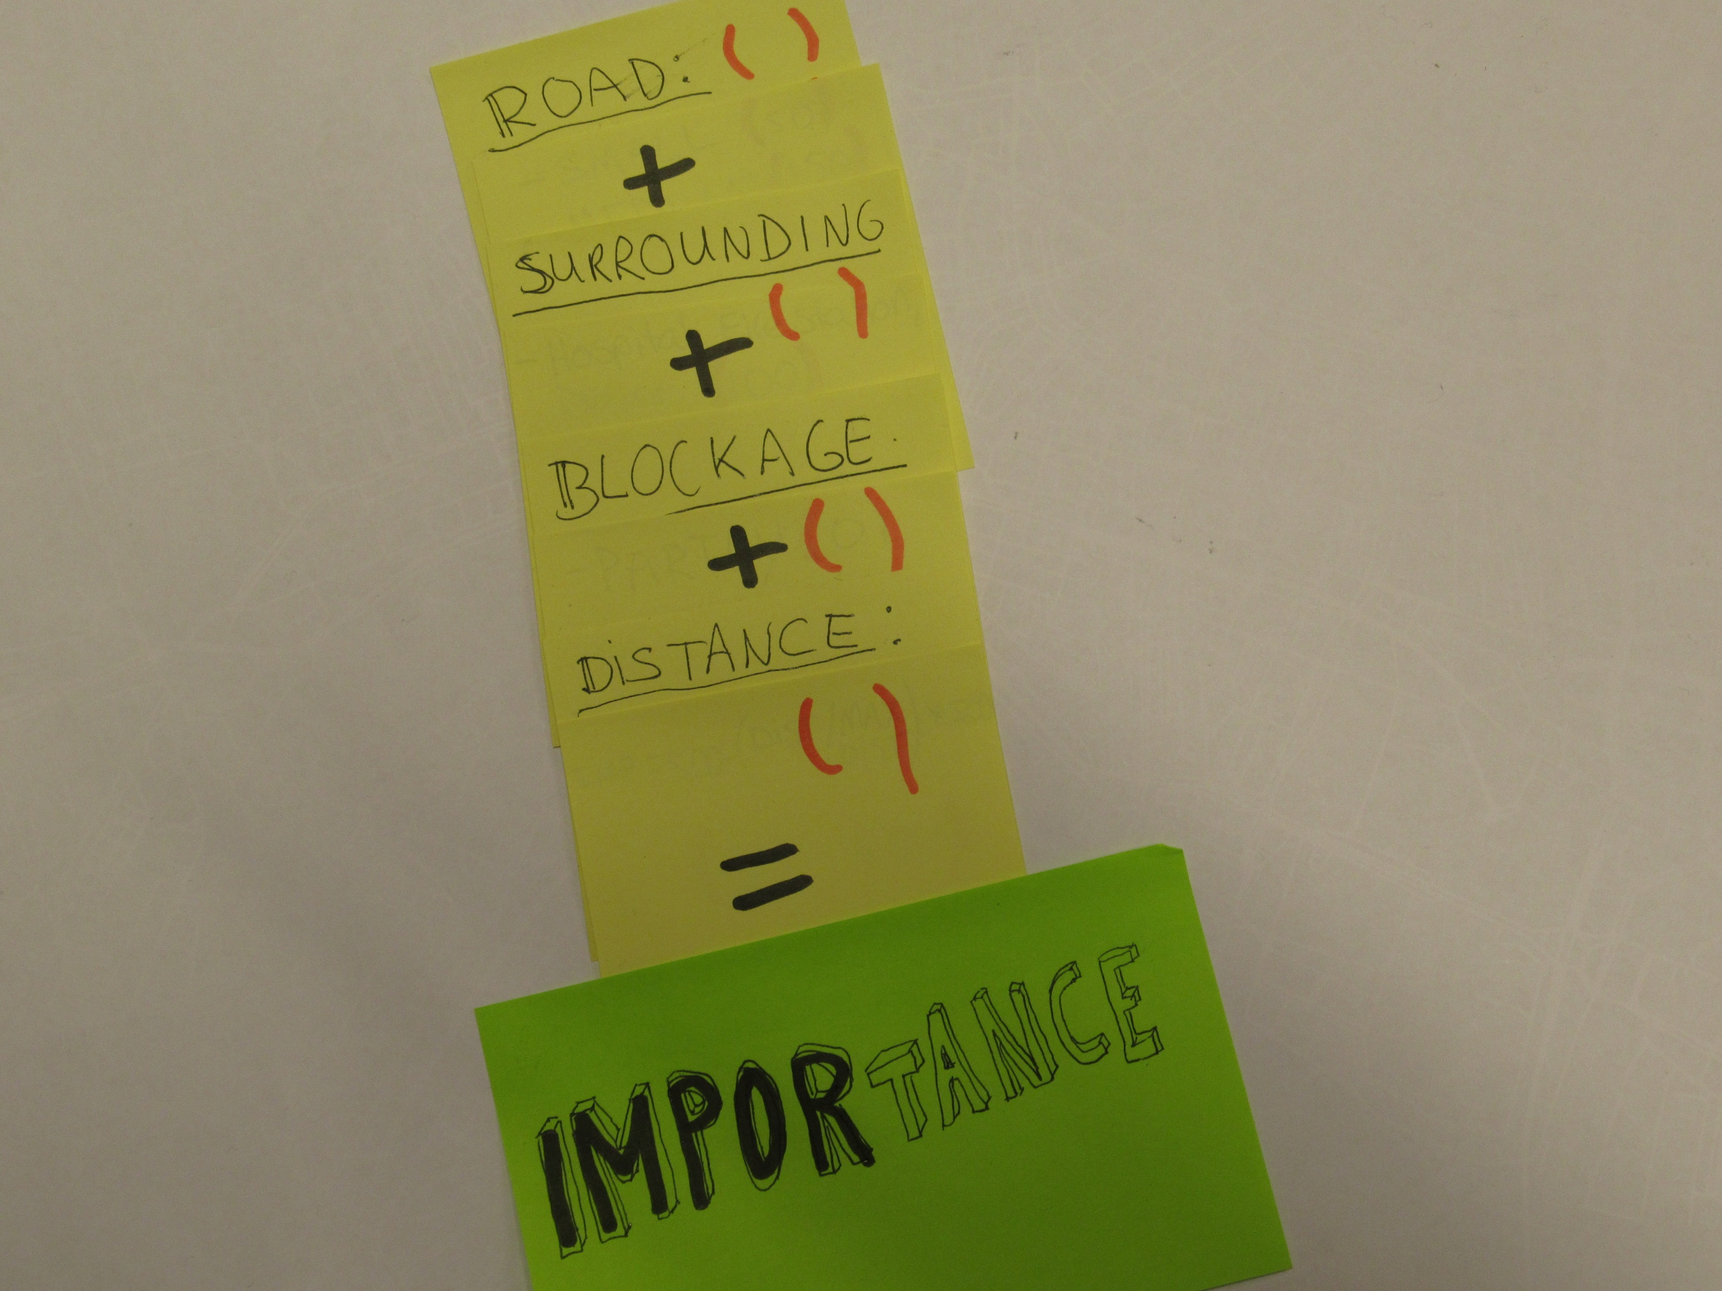

Slide 37
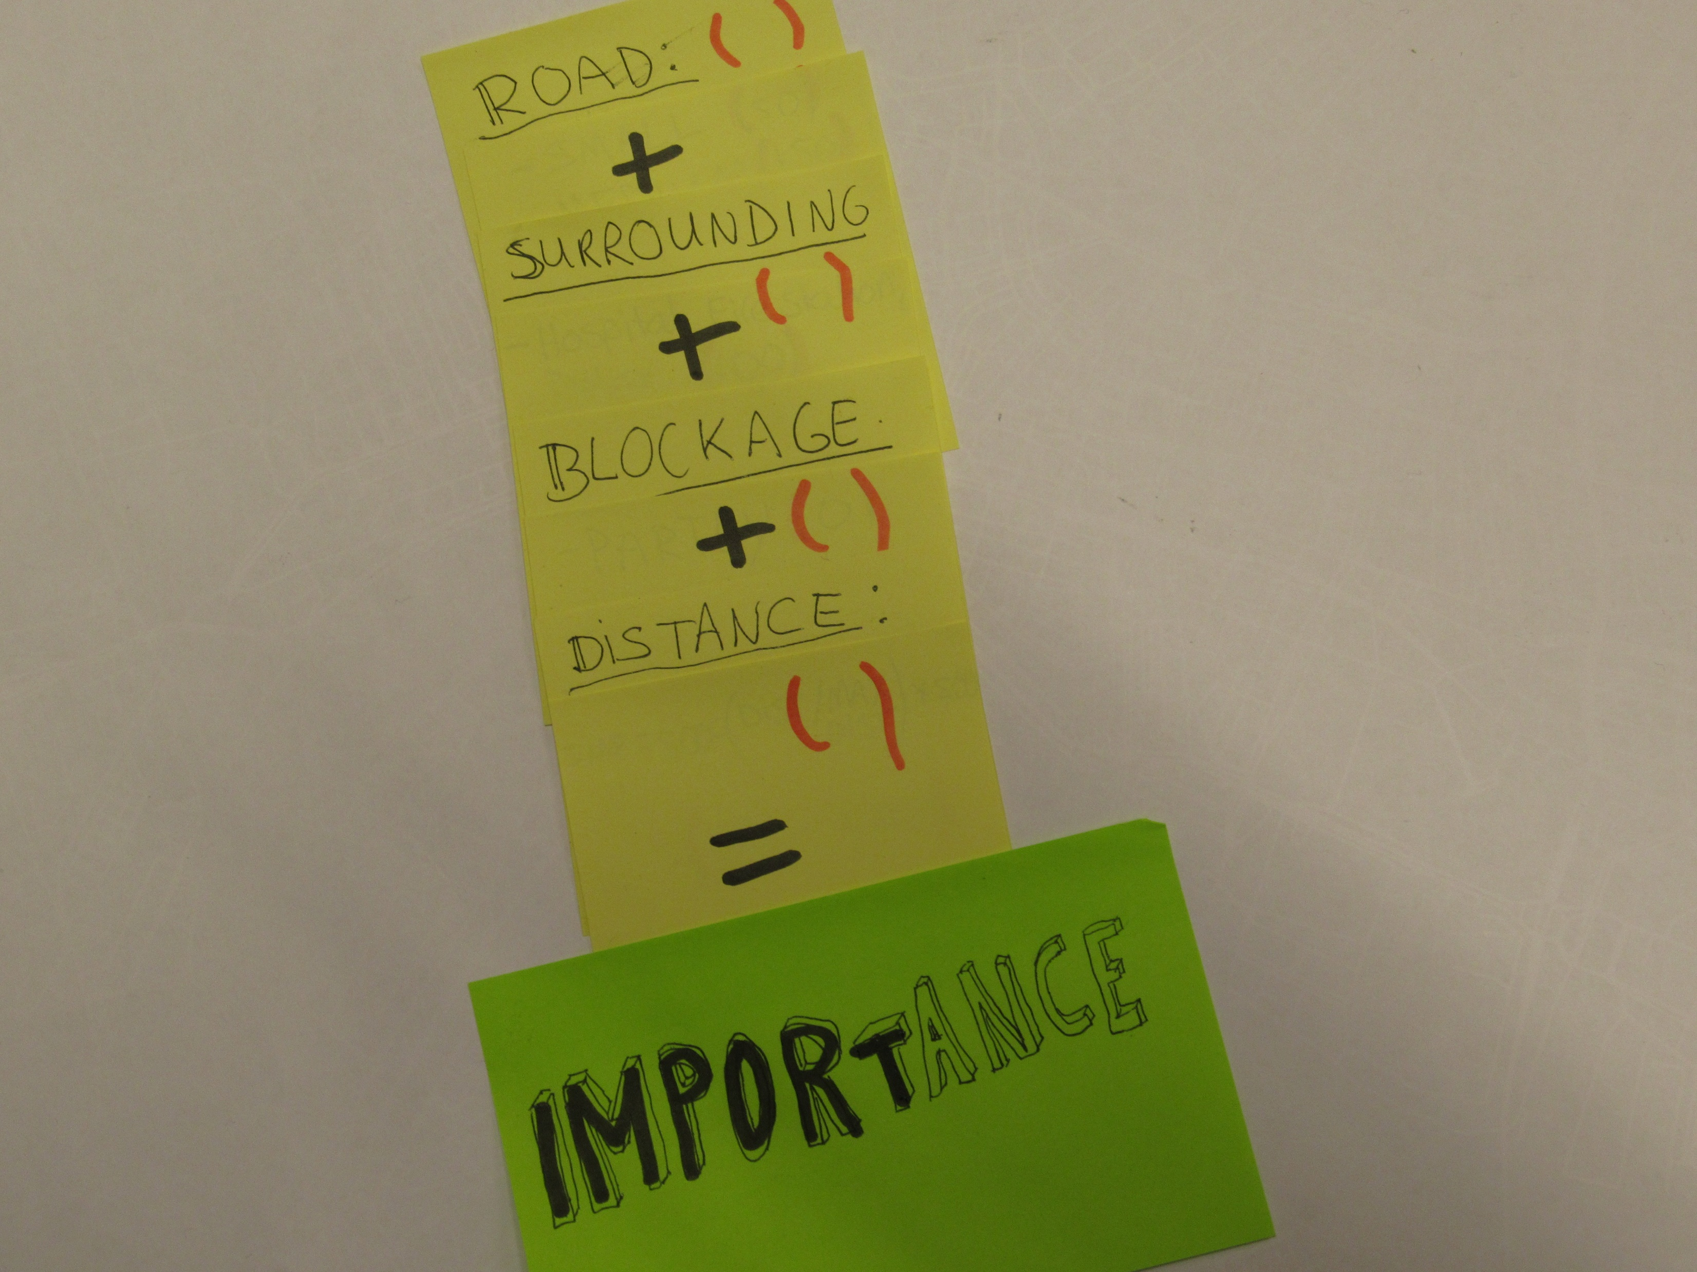

Slide 38
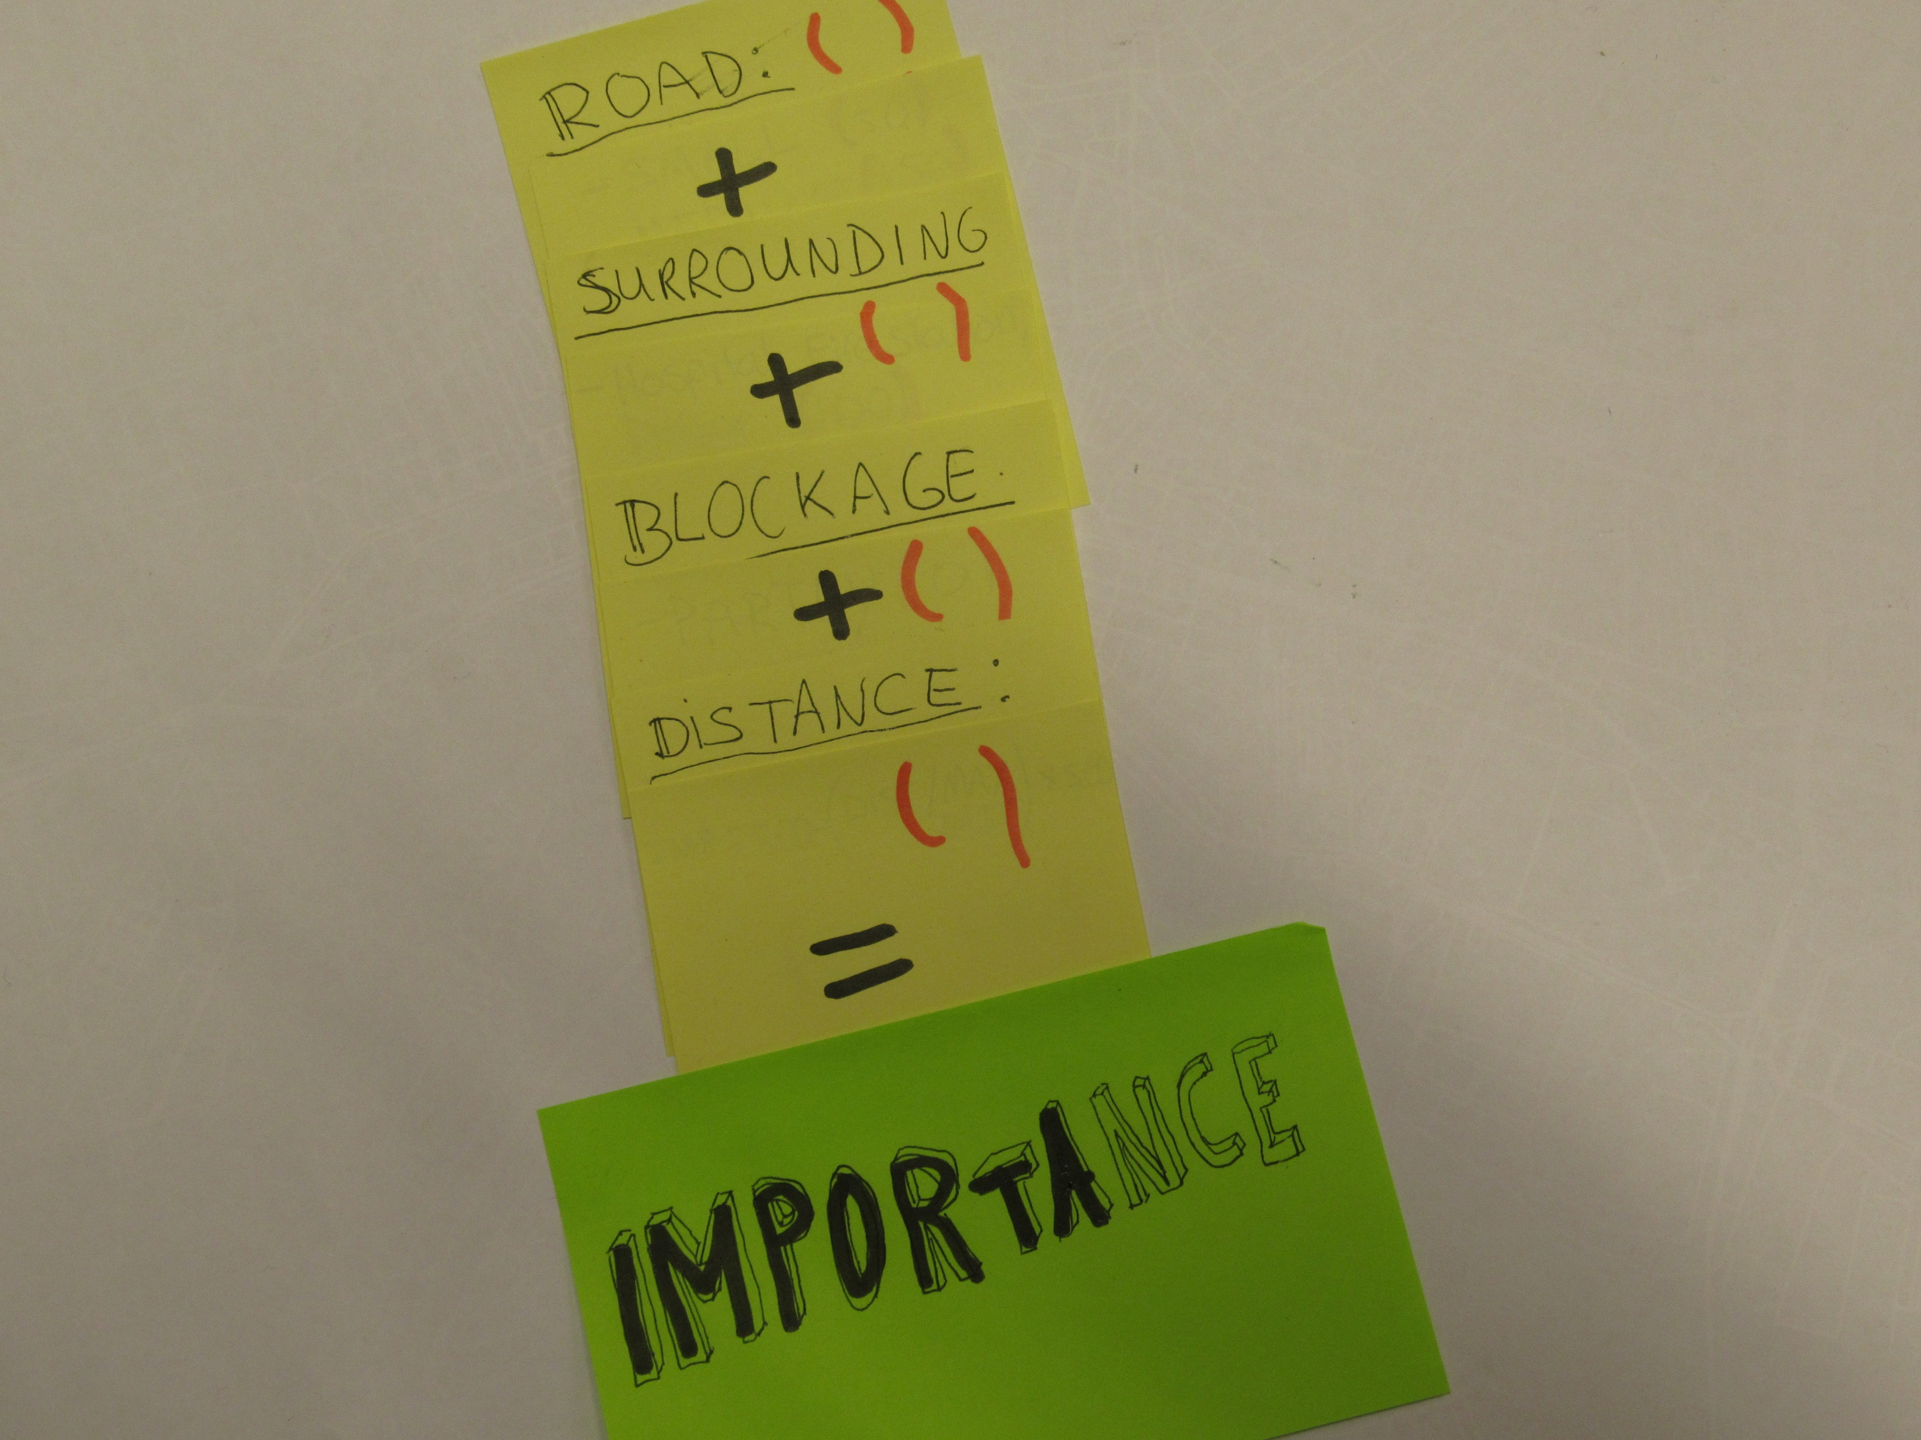

Slide 39
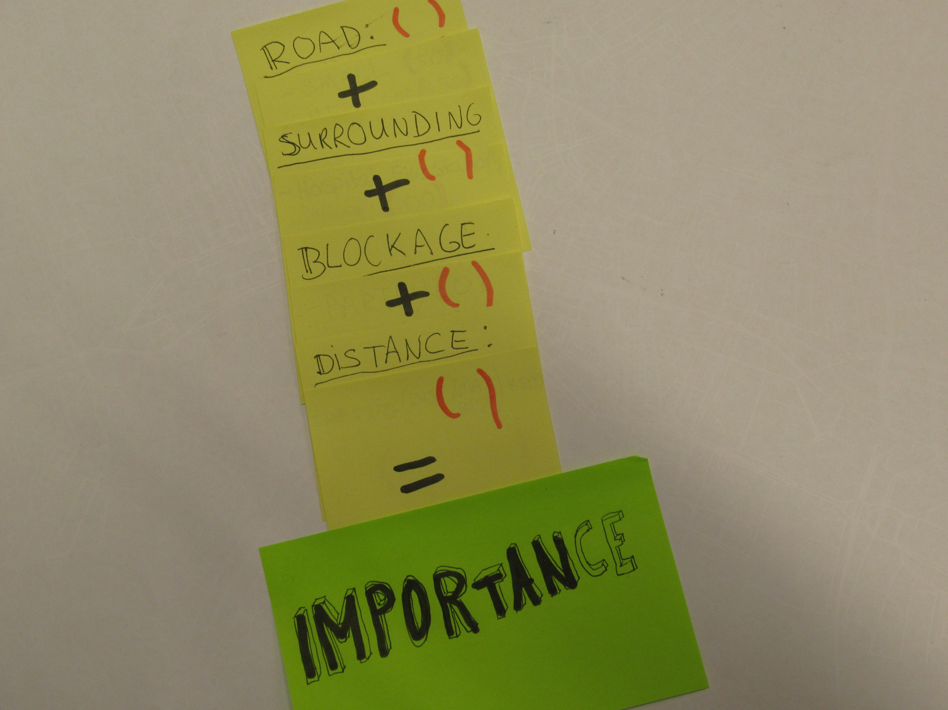

Slide 40
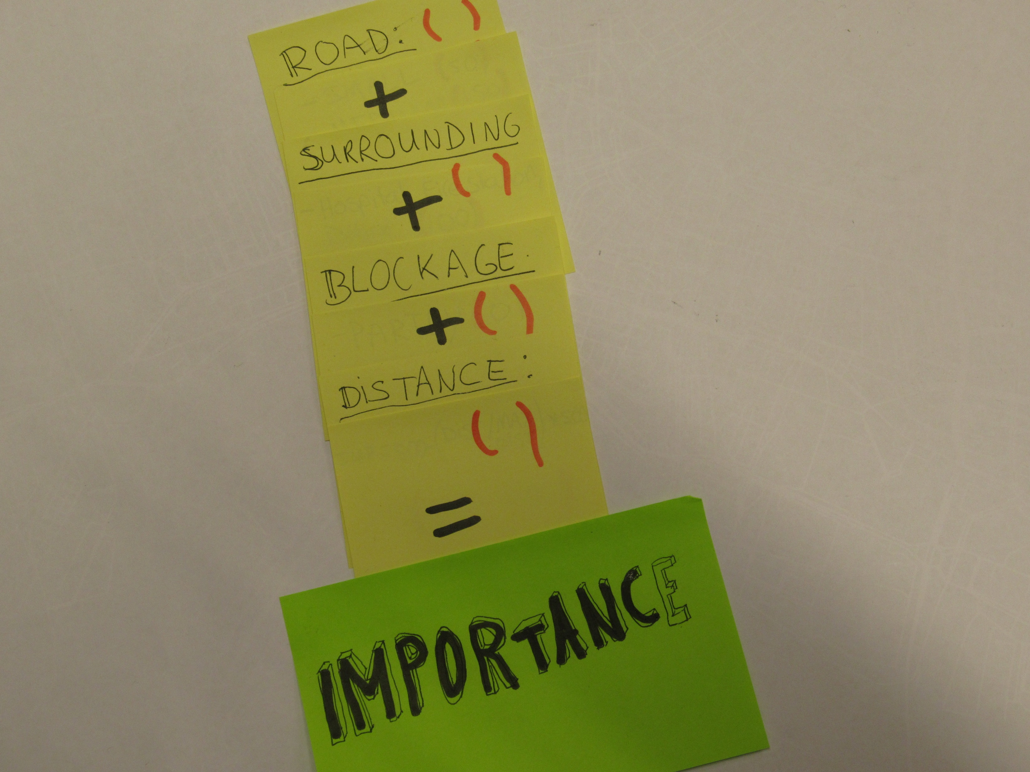

Slide 41
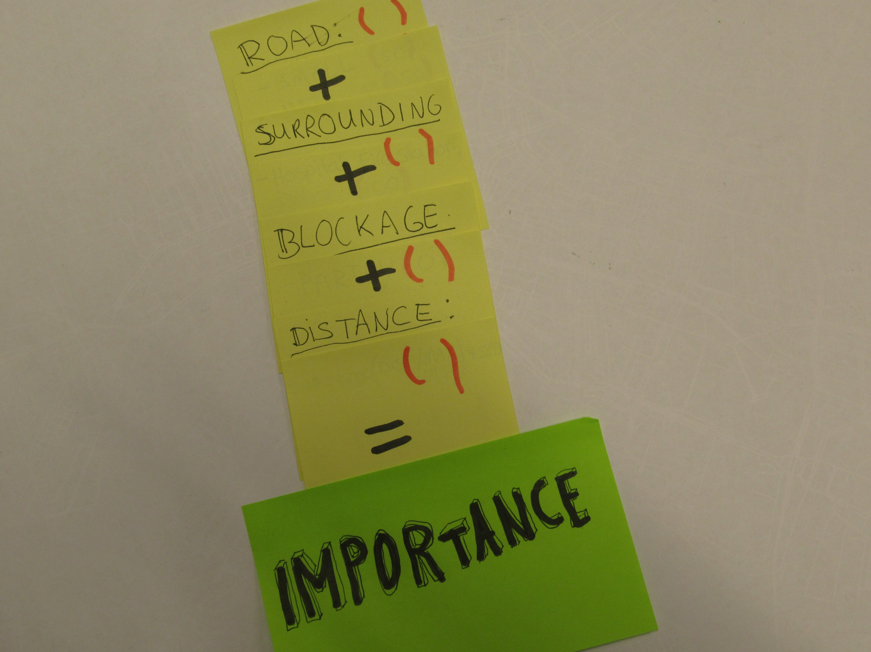

Slide 42
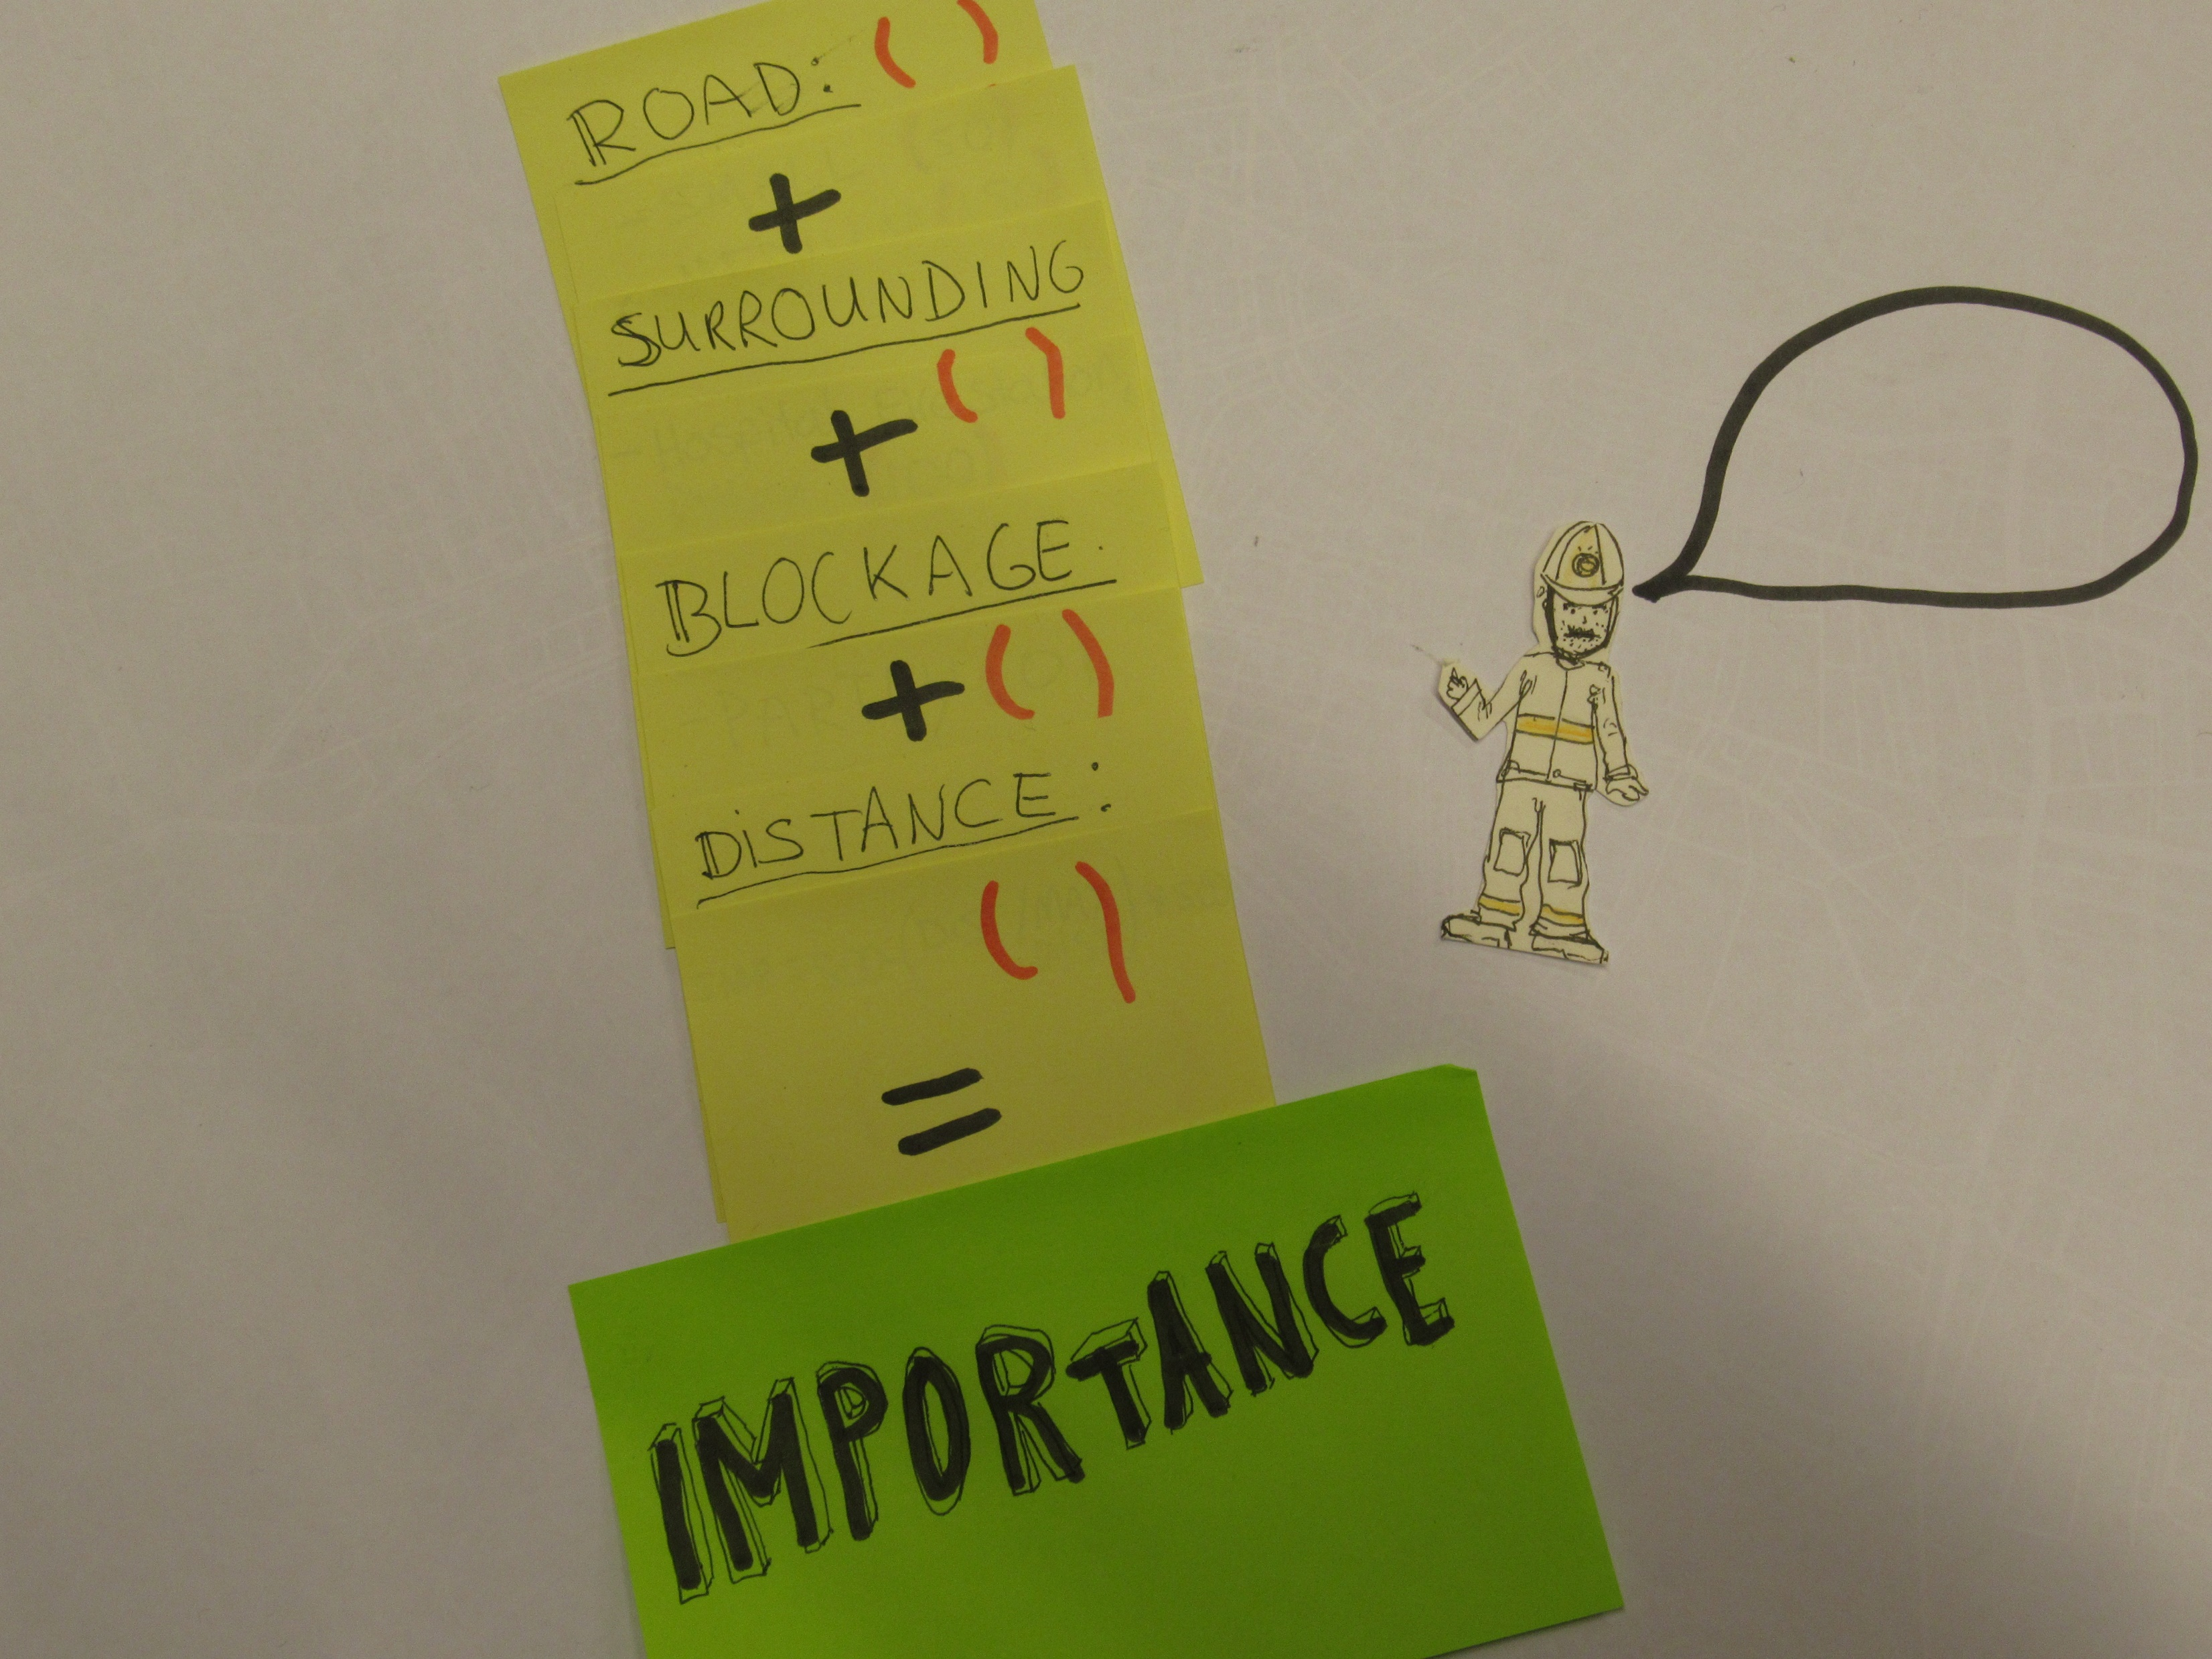

Slide 43
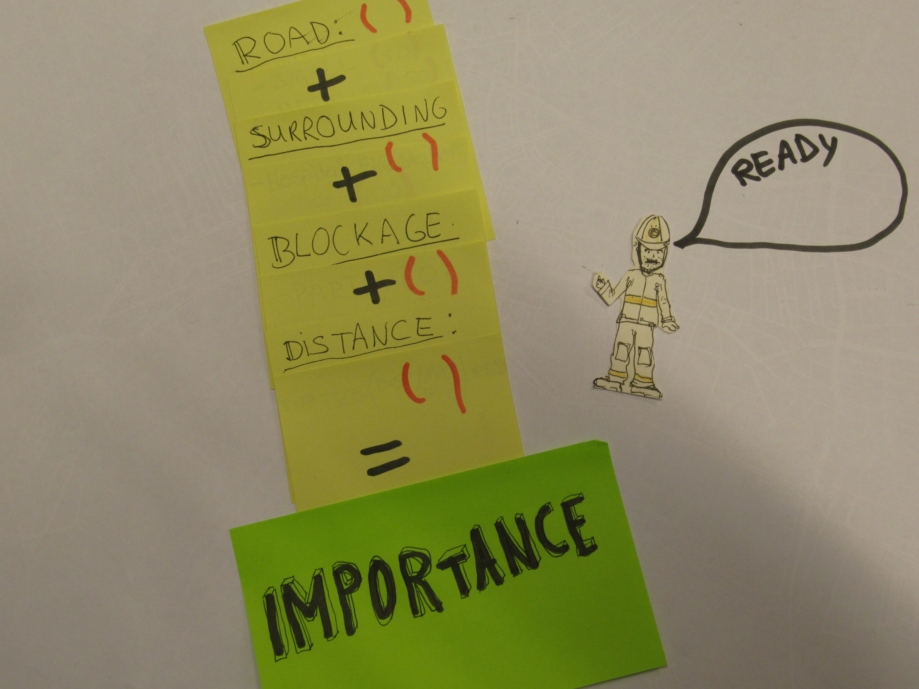
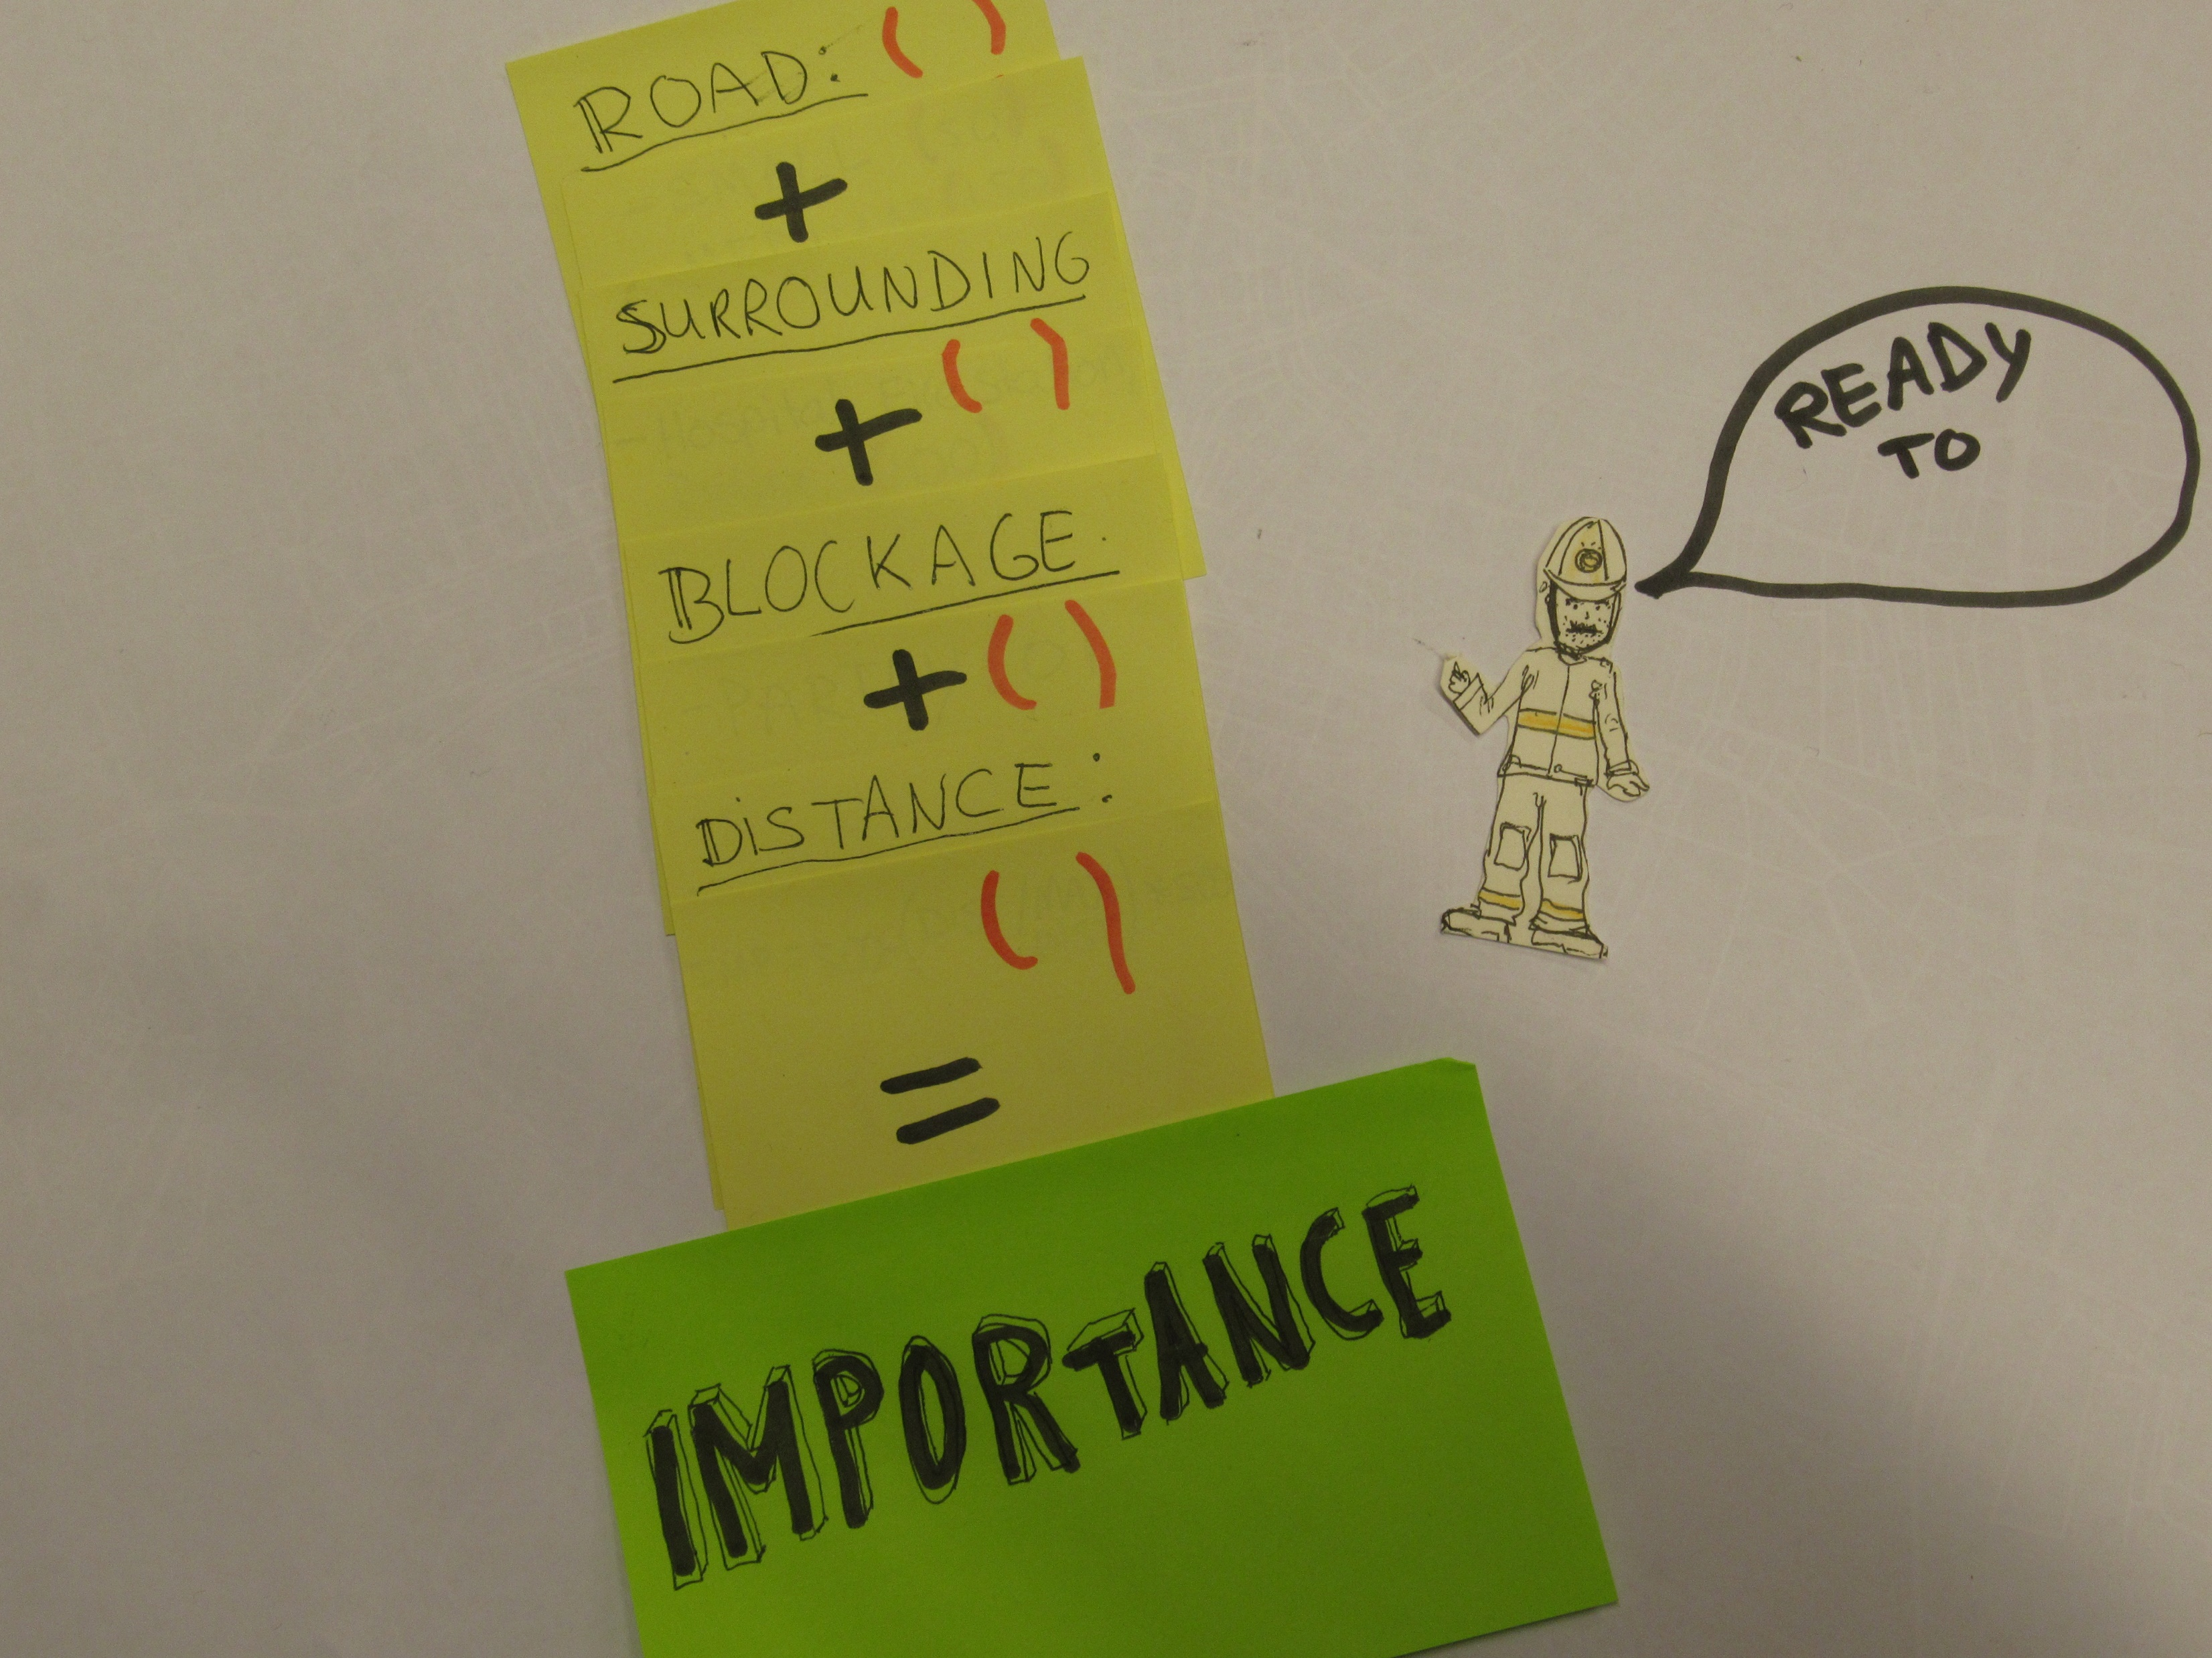

Slide 44
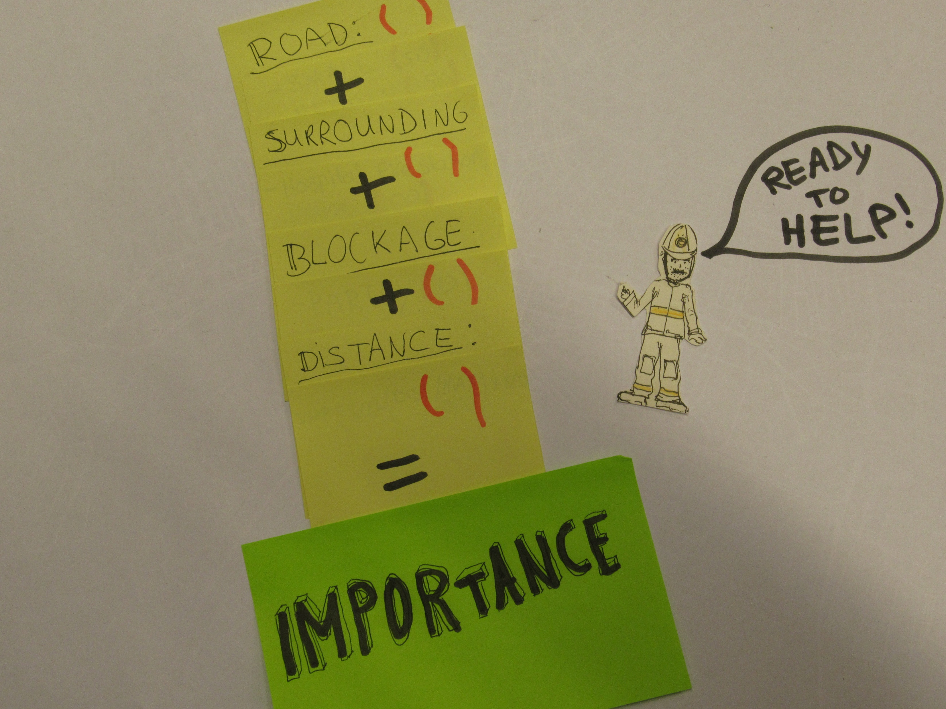

Slide 46
Importance
1. Why Beaufort?
2. User requirements
3. How does it work?
4. Visualisation
5. Future improvements
6. Conclusions
Road size: (50 – 150 – 250)
Important building nearby: (100)
Partly/fully blocked: (0/50)
Distance: 500 –(dist/maxdist)*500
+
Total importance

Slide 47
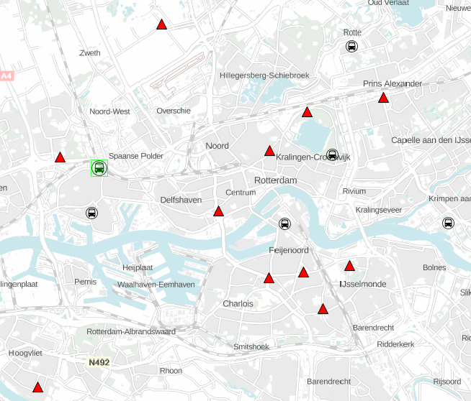
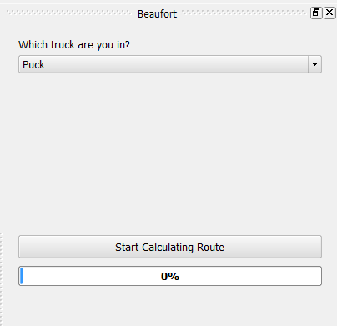
Visualisation
1. Why Beaufort?
2. User requirements
3. How does it work?
4. Visualisation
5. Future improvements
6. Conclusions
Overview of Rotterdam

Slide 48
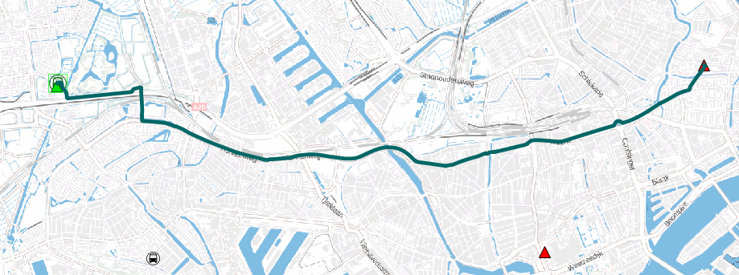
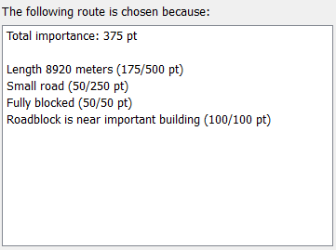
1. Why Beaufort?
2. User requirements
3. How does it work?
4. Visualisation
5. Future improvements
6. Conclusions
Zoom-in on the route
Shows why you have to go somewhere

Slide 49
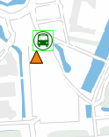
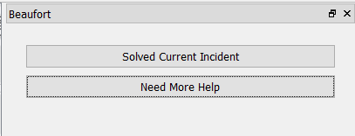
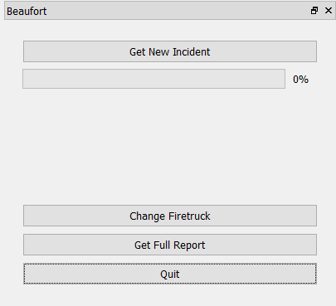
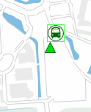
1. Why Beaufort?
2. User requirements
3. How does it work?
4. Visualisation
5. Future improvements
6. Conclusions
Doesn’t do much yet:
need multiple users

Slide 50
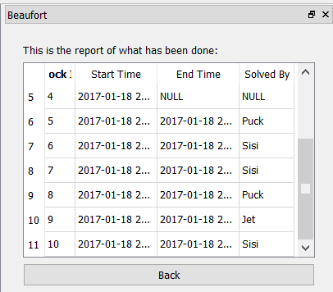
Get full report
1. Why Beaufort?
2. User requirements
3. How does it work?
4. Visualisation
5. Future improvements
6. Conclusions
For logging and comparison purposes

Slide 51
Future improvements
1. Why Beaufort?
2. User requirements
3. How does it work?
4. Visualisation
5. Future improvements
6. Conclusions
Real Time:
Position trucks with GPS
New roadblocks added by dispatch or firemen
Finetune algorithm of importance
Don’t drive on blocked roads
Focus on more than only roadblocks?

Slide 52
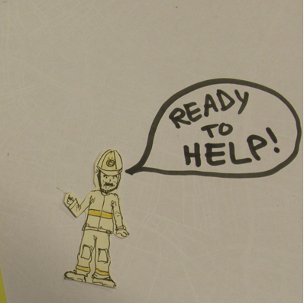
Conclusions
1. Why Beaufort?
2. User requirements
3. How does it work?
4. Visualisation
5. Future improvements
6. Conclusions
In what order to solve which roadblocks with which trucks?
Importance system
Minimalistic > clear and easy to use

